Slide 1
The Best of the Best
At the 2023 Annual Marketing, Sales and Service Summit

Slide 2

Tingue

Slide 3
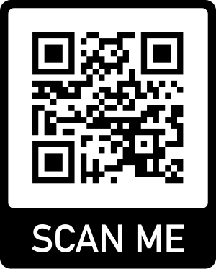
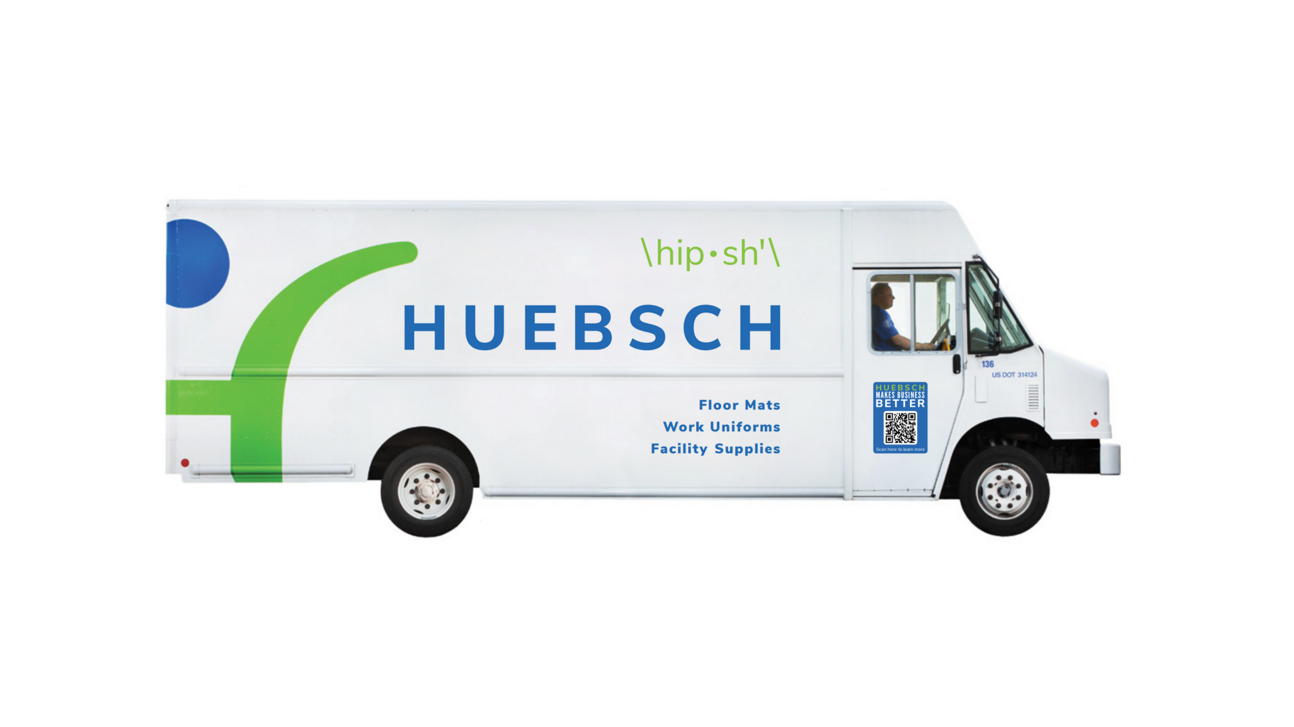
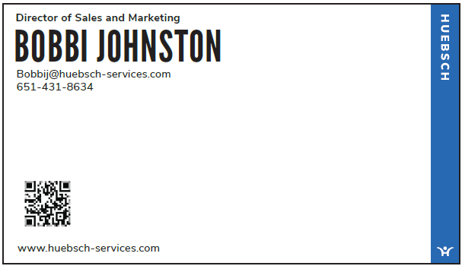
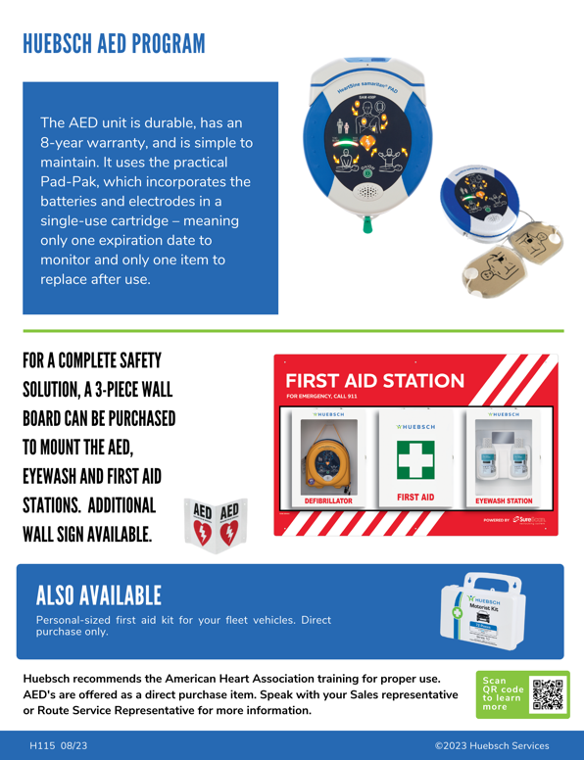
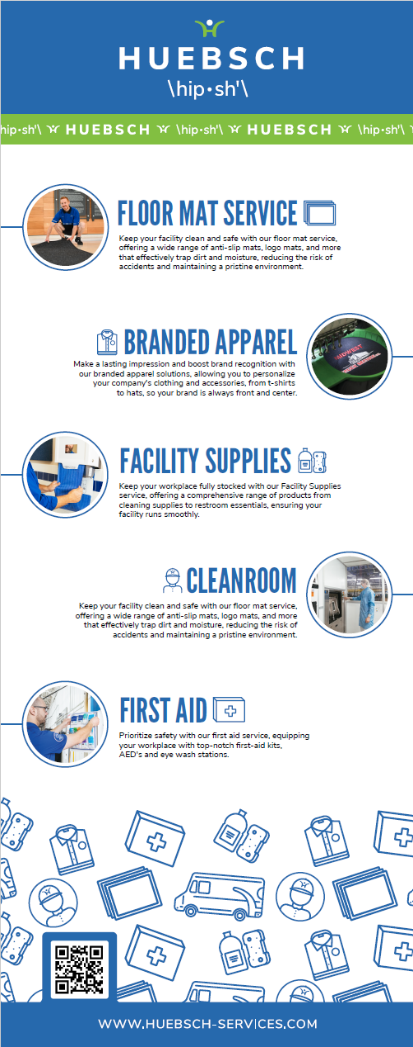

HUEBSCH SERVICES
Where do we place them?
Trucks, Brochures, Trade Show Banners, Business Cards
Goal: Increase Website Traffic and Web Lead Submissions
Outcome: Since starting to utilize QR codes, our lead forms have increased by 24%. We can track where scans happen in our market for future planning. Generated for free. Only cost is to print.
Notes:
- We can track where leads are coming in from (physical location) to watch trends
-In 5 months we have had over 100 new scans from those who may not have visited our site otherwise
-New web leads have increased by 20% over the last 5 months

Slide 4
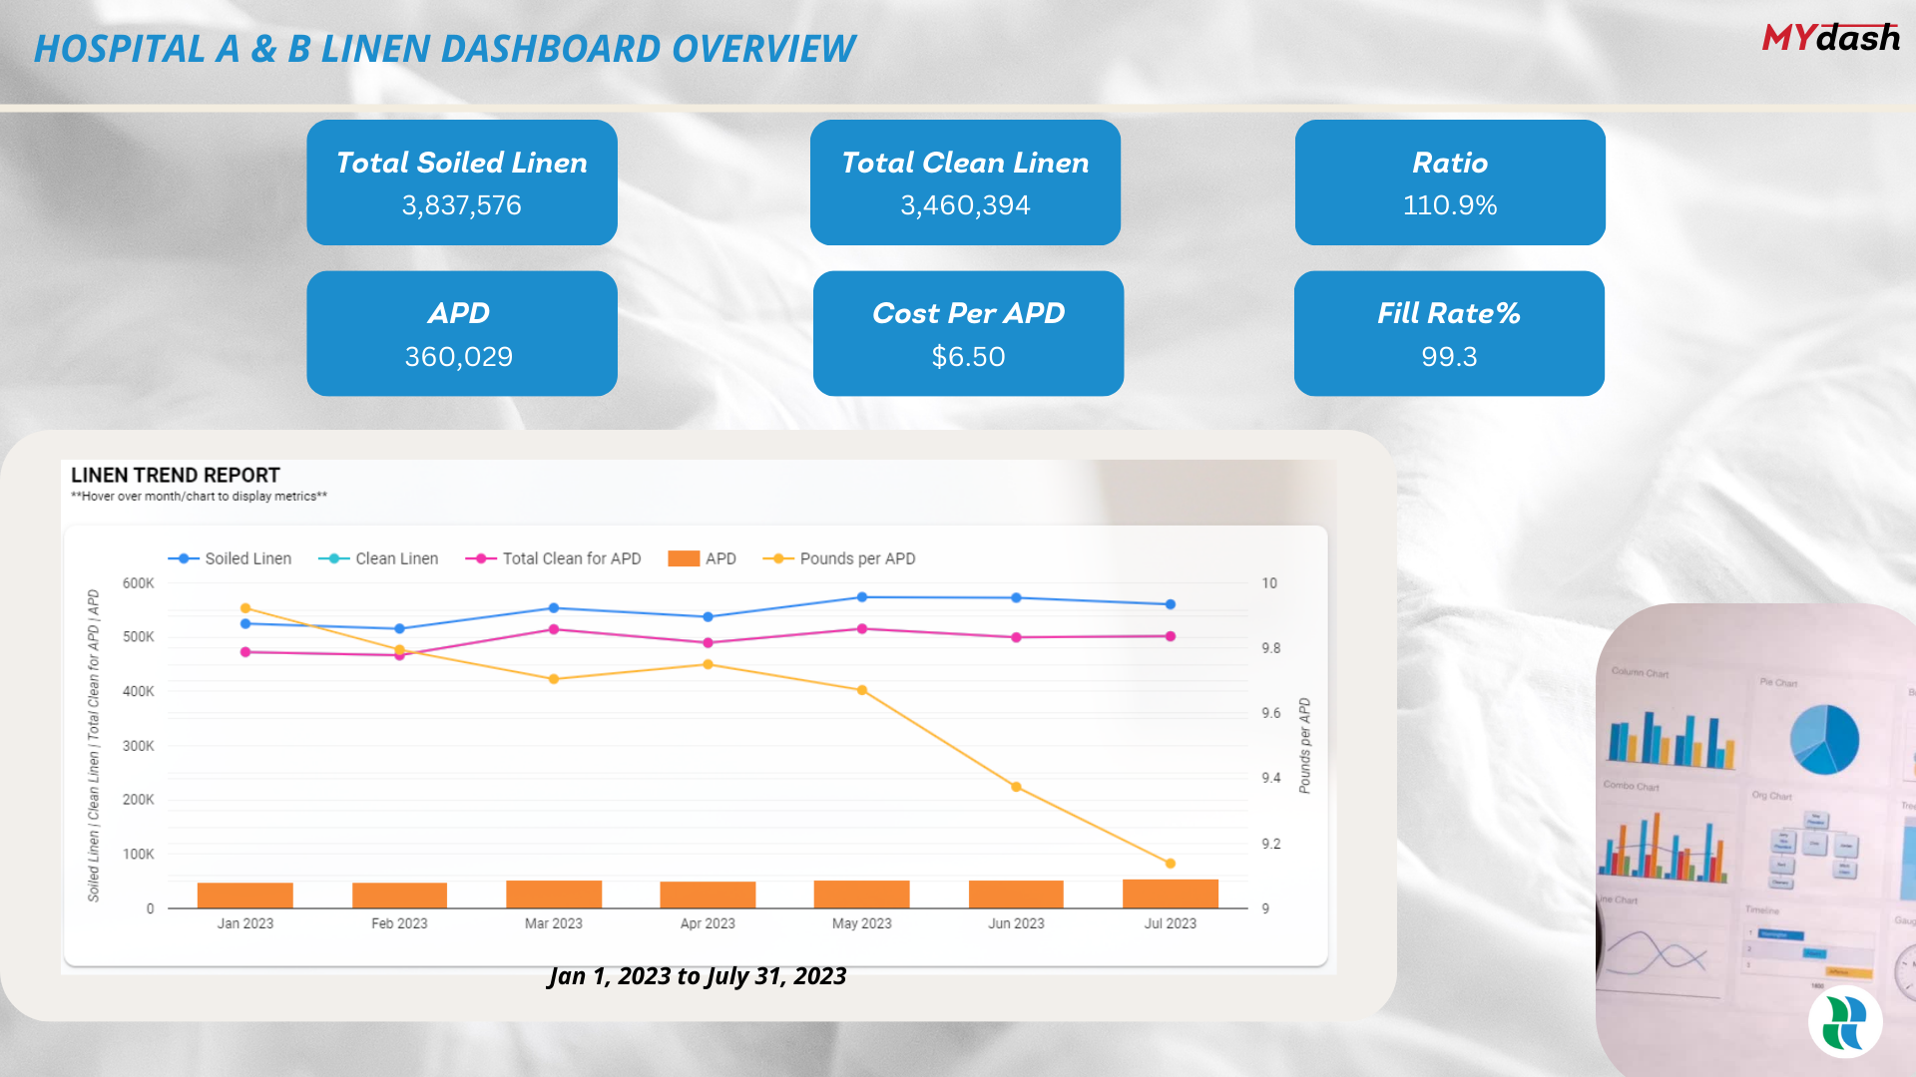
Healthcare Linen Services Group

Slide 5
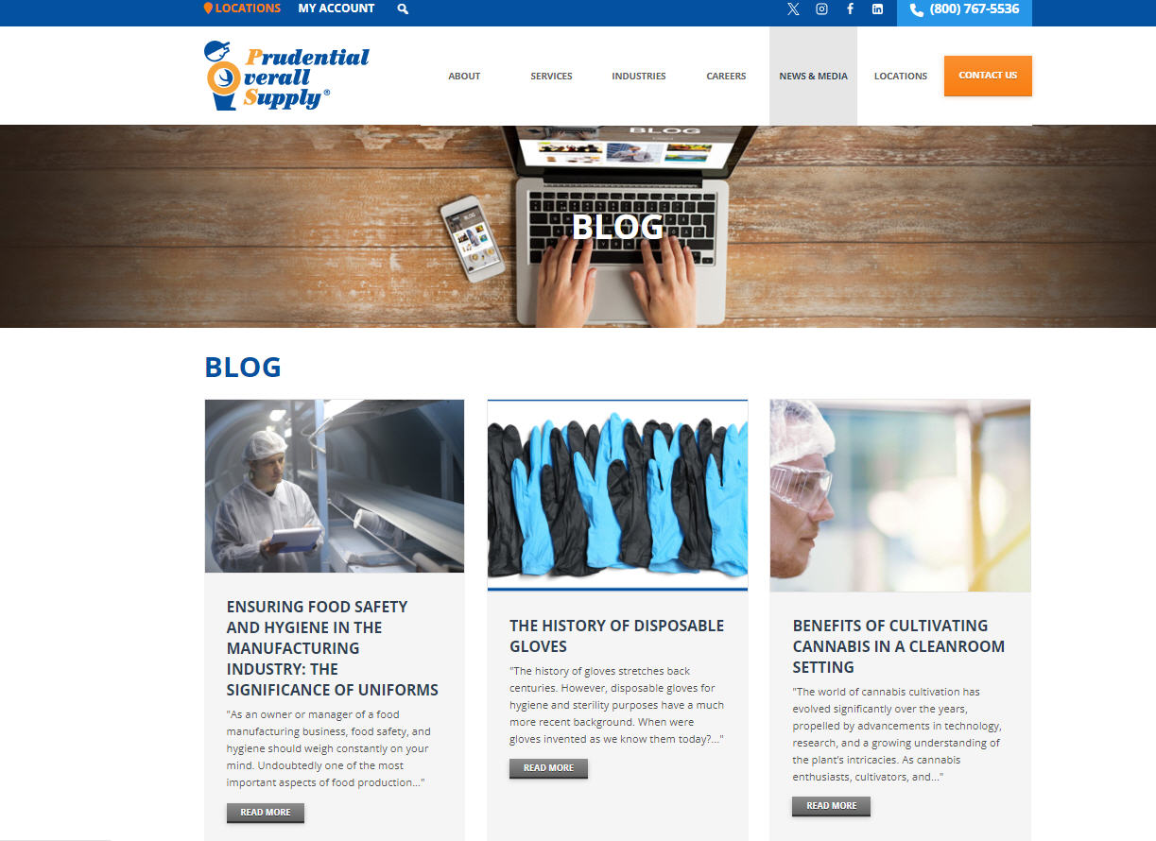
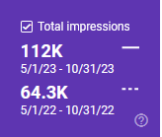
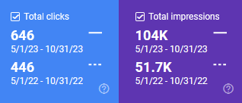
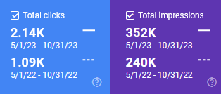
Prudential Overall Supply

Slide 6

Alsco

Slide 7
The Best of the Best
At the 2023 Annual Marketing, Sales and Service Summit

Slide 8

Workwear Outfitters

Slide 9

M+A Matting

Slide 10

Infinite Laundry

Slide 11
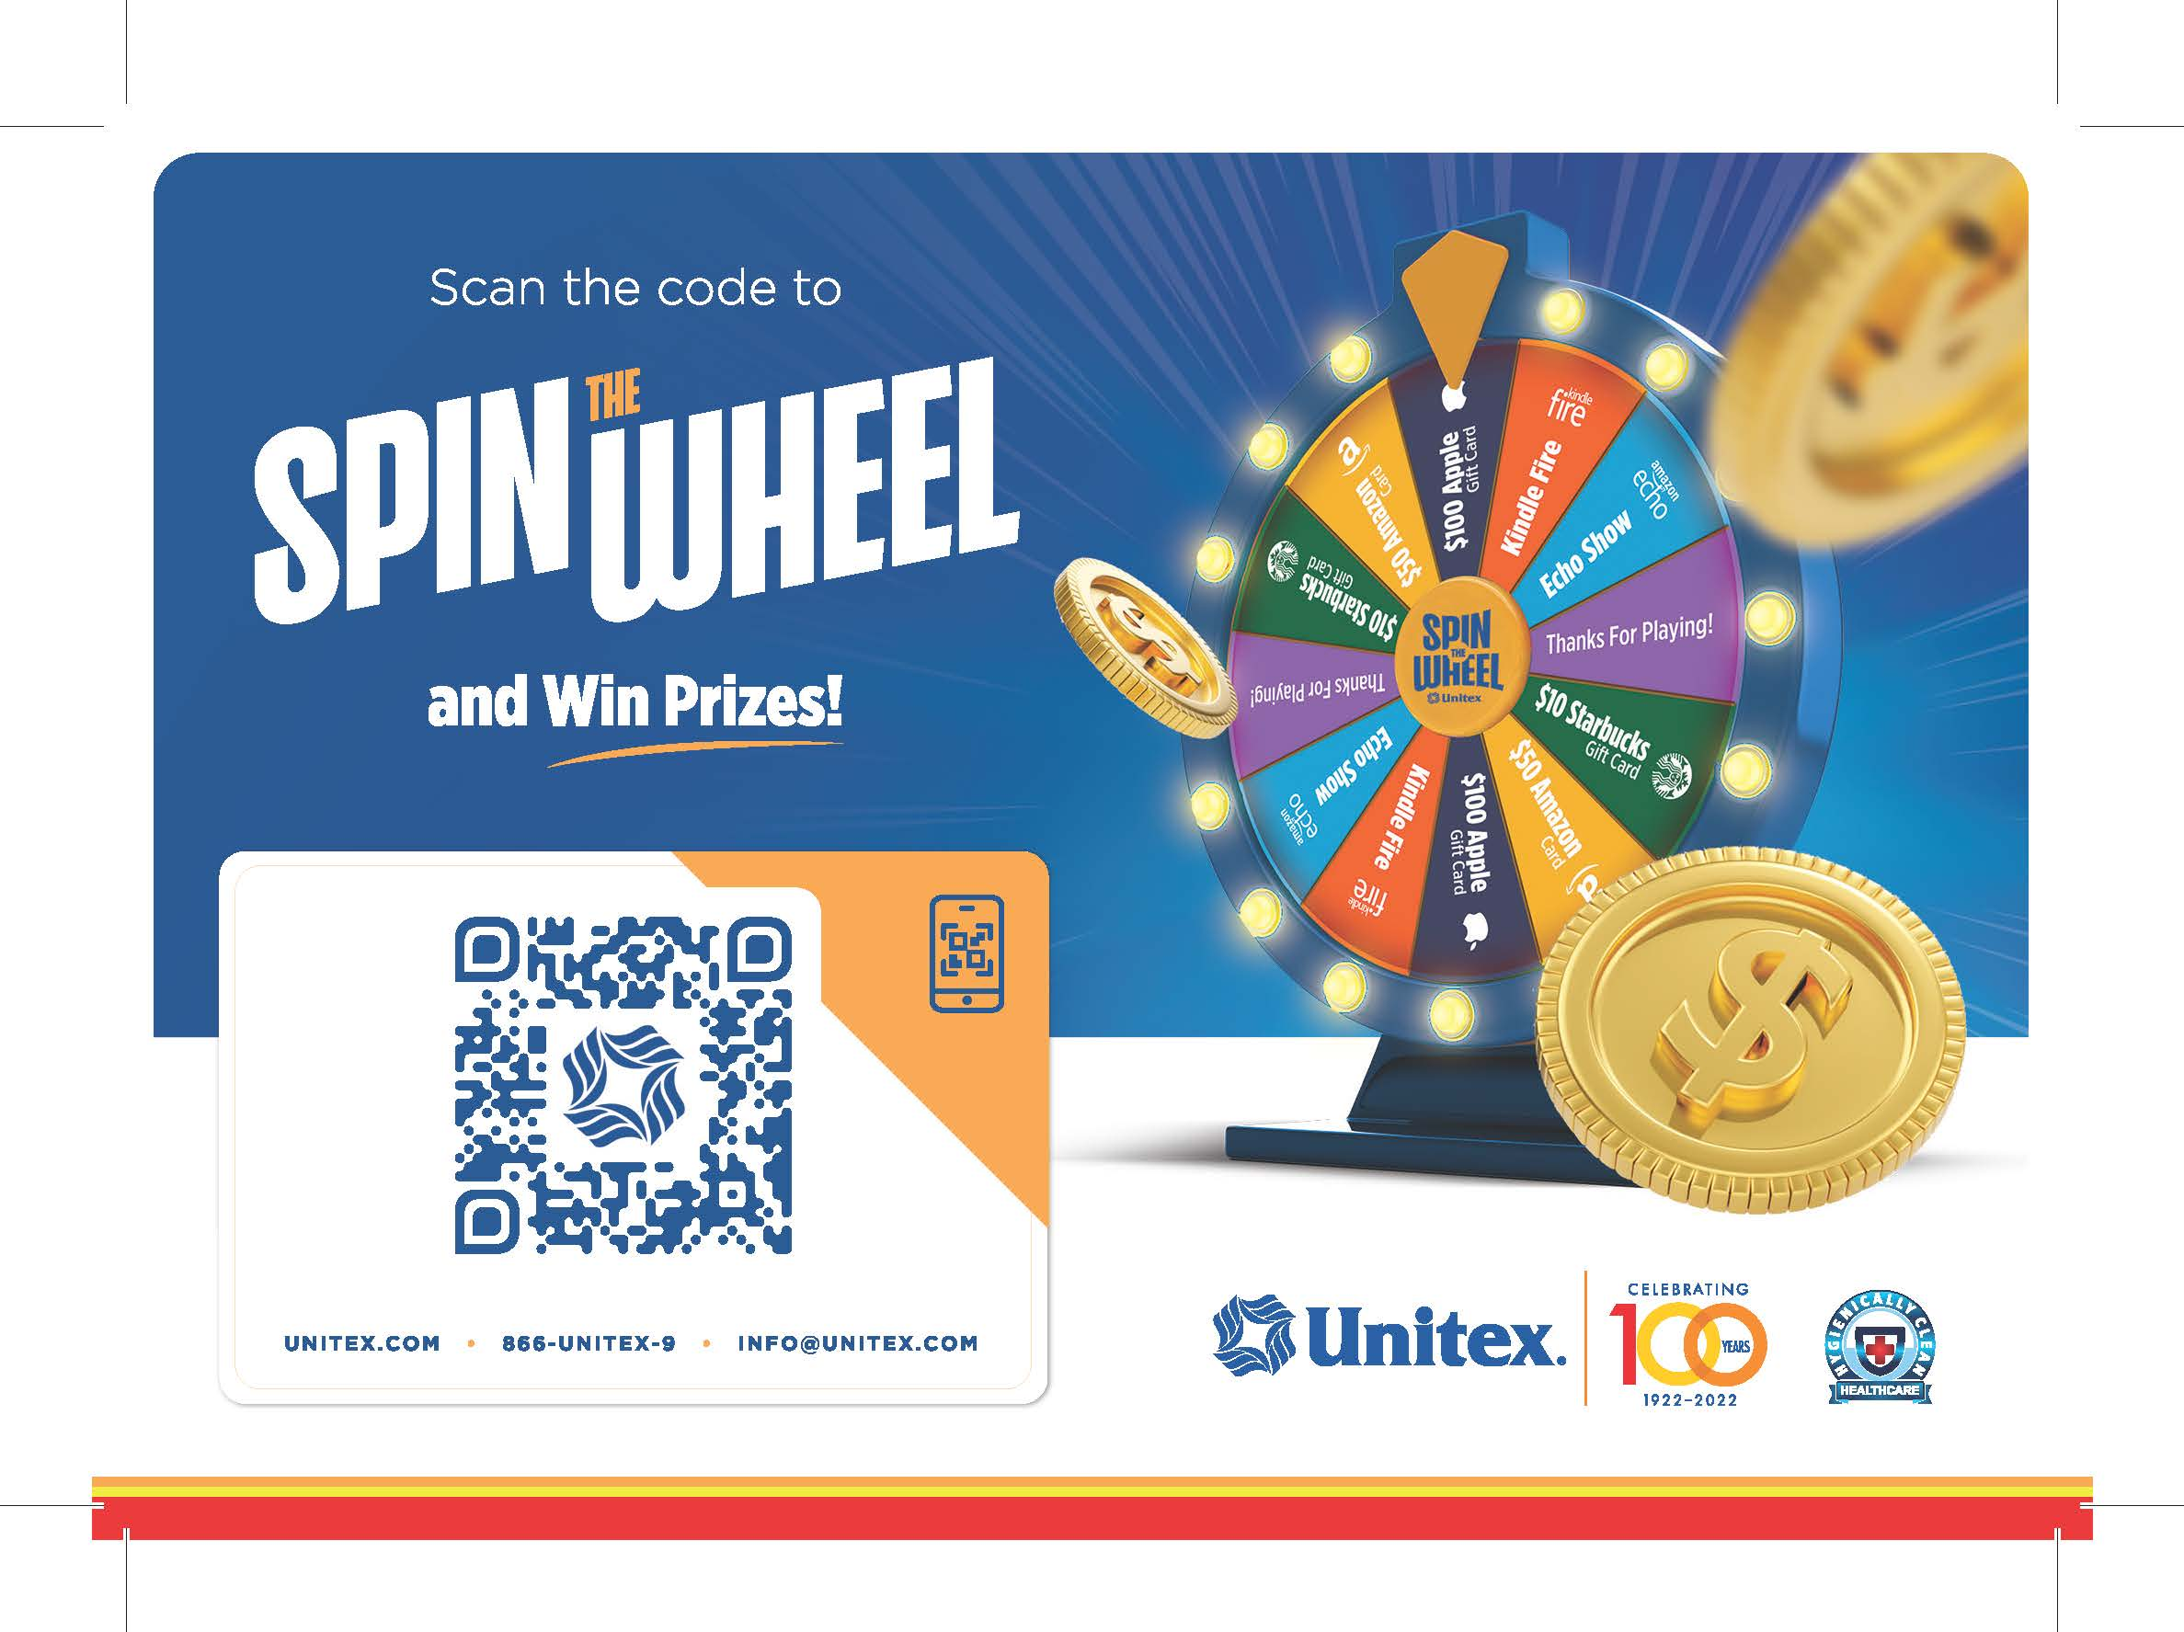
Unitex Healthcare Laundry Services

Slide 12
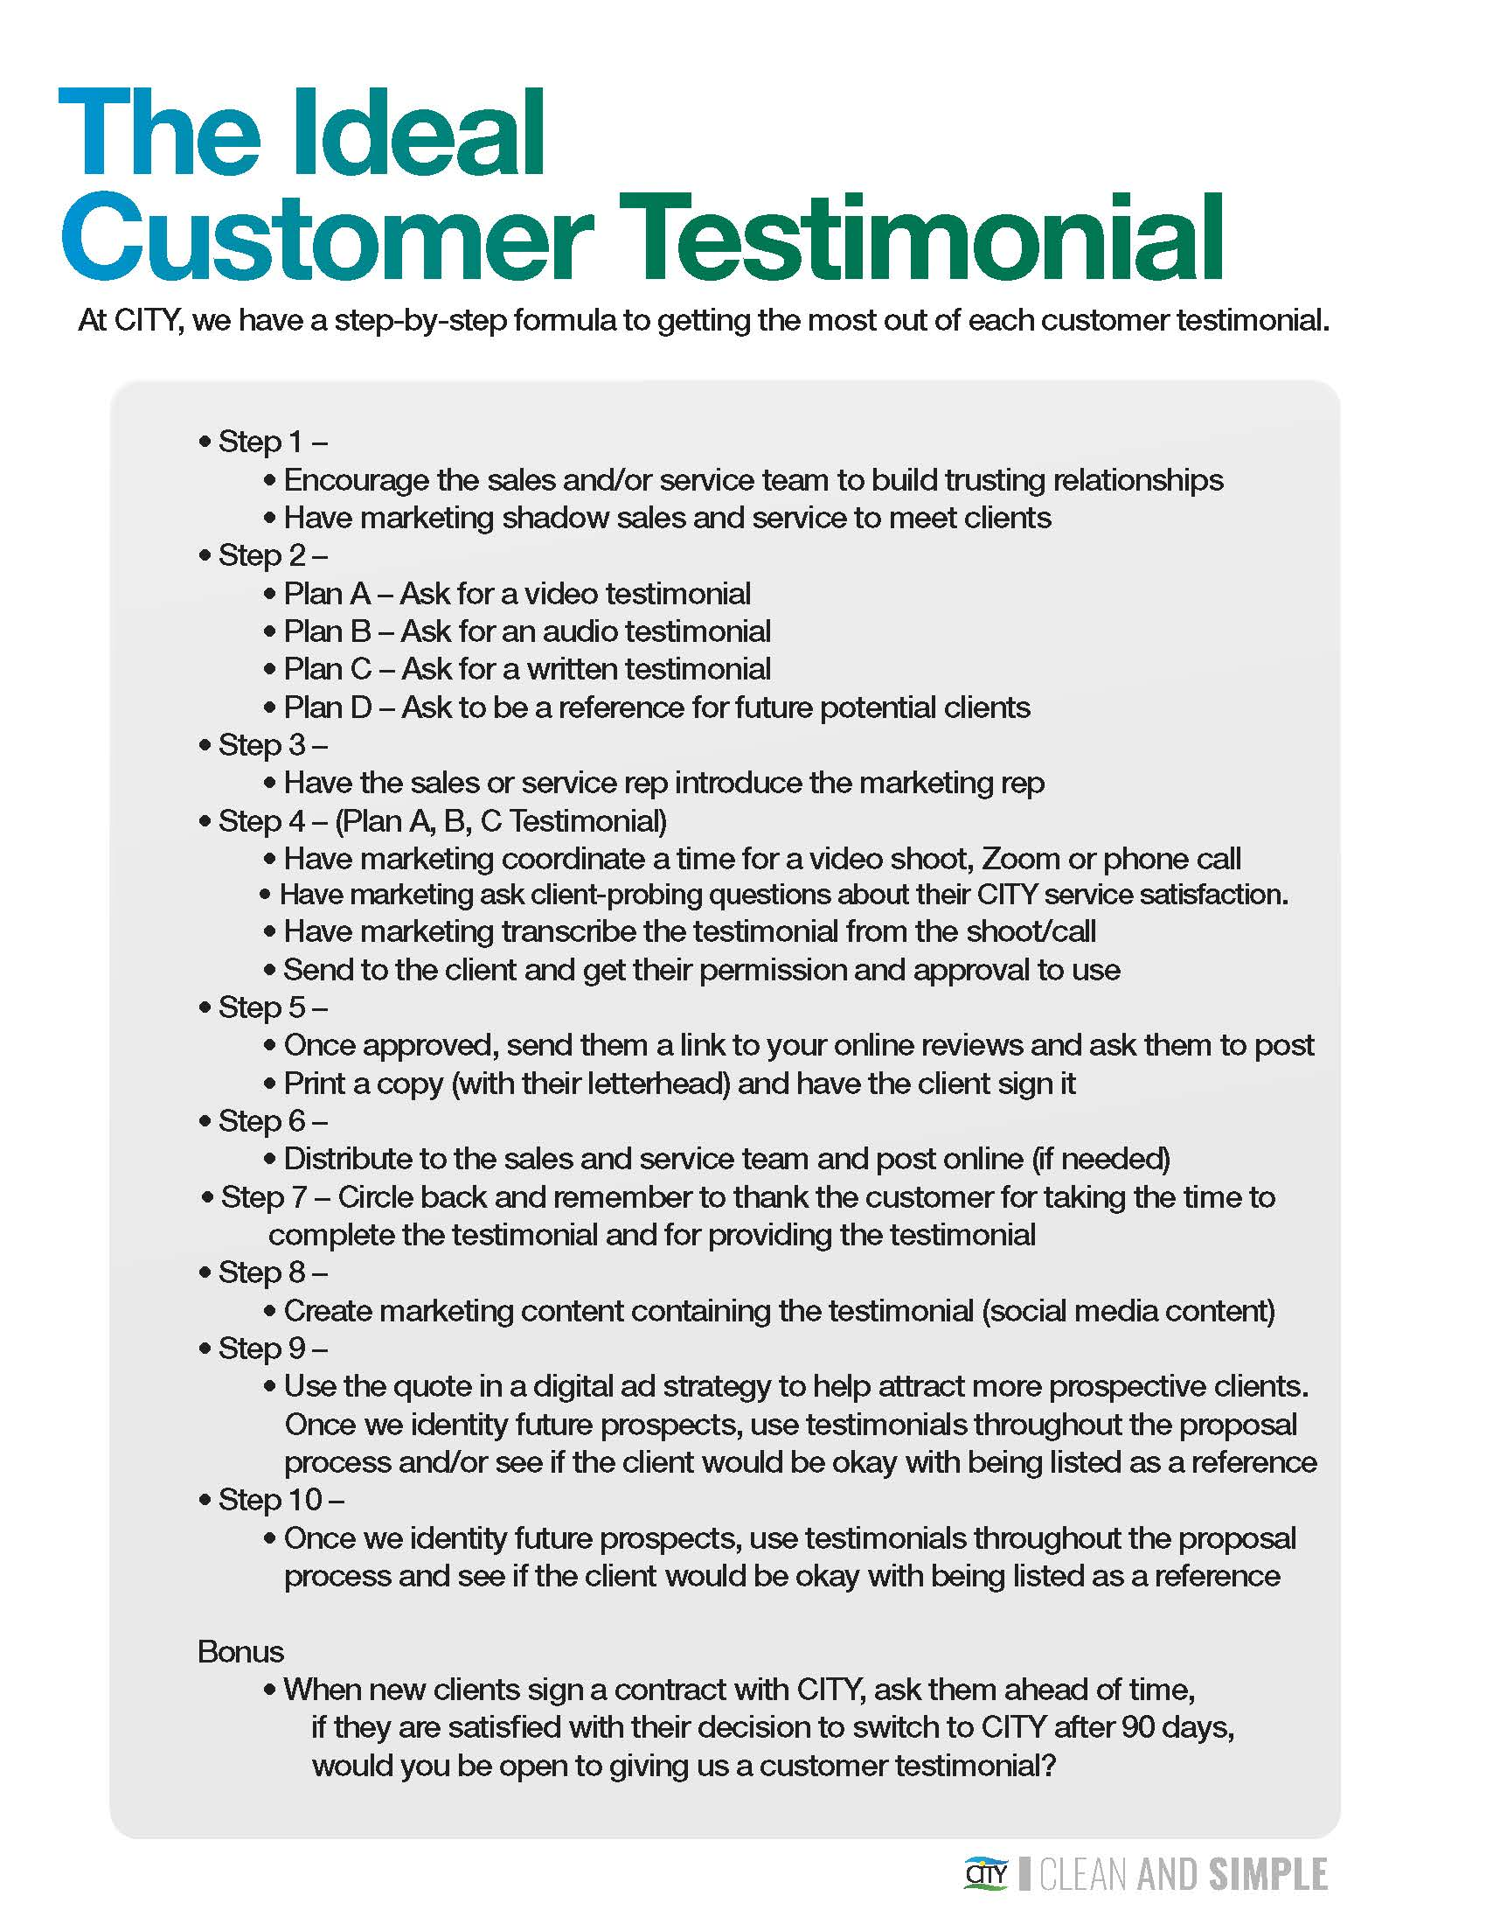
CITY Laundering co.

Slide 13

Wingmate

Slide 14
The Best of the Best
At the 2023 Annual Marketing, Sales and Service Summit

Slide 15


Who was the Best of the Best?
ⓘ Start presenting to display the poll results on this slide.

