Slide 1
BEST OF THE BEST
7th Annual Marketing, Sales & Service Summit

Slide 2

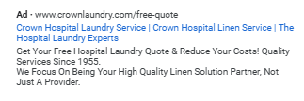
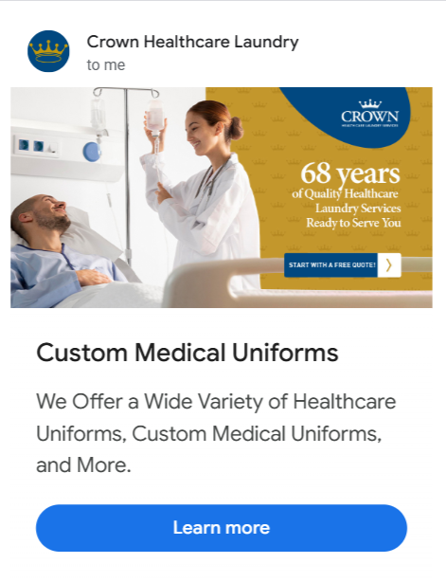
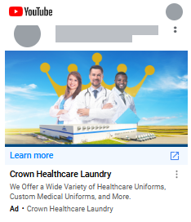
Full-Funnel Digital Marketing Approach Leads to More Leads at a Lower Cost -
A Partnership Between Crown Healthcare Laundry Services and Infinite laundry
Top of funnel:
High-Intent Search
Middle of funnel:
Broad Remarketing
Bottom of funnel:
Purchase Intent
New Lead

Slide 3


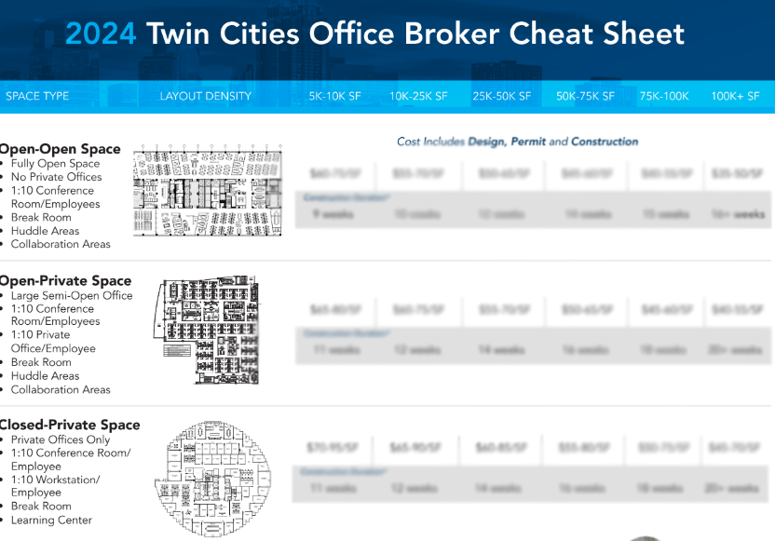
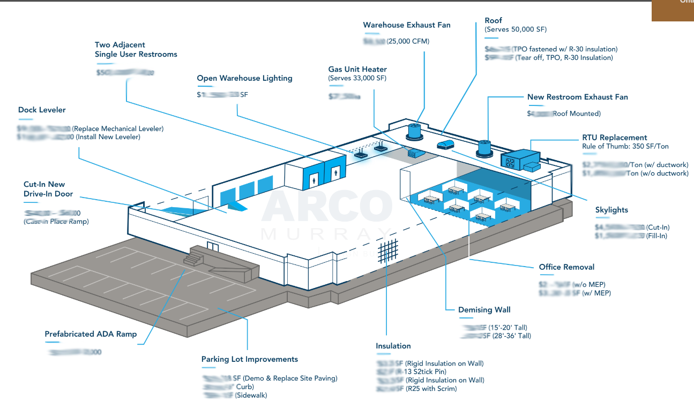
COME ON DOWN!
CREATIVE LEAD GENERATION
OVERVIEW
Transformed golf hole sponsorship into a lead-generation tool.
Provided brokers with valuable unit cost information to encourage contact sharing.
Created region specific office and industrial unit cost data.
Price is Right” themed game where brokers guessed unit costs.
Connection opportunity was “gamified” to facilitate interaction.
Winners received detailed cost sheet takeaway.
Brokers gained valuable unit cost insights to enhance conversations with their clients

Slide 4
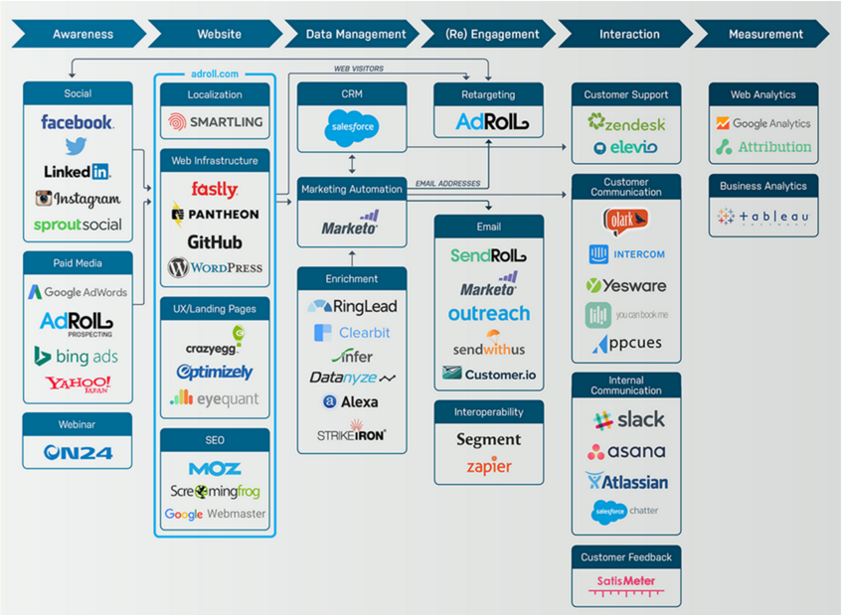

Digital Marketing Cycle Stages & the Marketing Tech Stack
The digital marketing cycle consists of several interconnected stages that businesses use to effectively market to their audience online, build brand presence, enhance customer engagement, and drive sales.
Marketing Qualifying Leads (MQL) --> Sales Qualifying Leads (SQL)
Awareness: Increase brand visibility through SEO, social media, and paid ads.
Website: Optimize the website for user experience and conversions, acting as a digital storefront.
Data Management: Use CRM systems and analytics to understand customer behavior and preferences.
Re-engagement: Utilize retargeting ads and email campaigns to bring back previous visitors.
Interaction: Engage ongoing with customers via social media and encourage reviews to build loyalty.
Measurement: Analyze metrics like traffic, conversion rates, and ROI to inform future strategies.
Objective: Strengthen digital presence via organic engagement.
Key Achievements:
YTD 397% increase in user engagement;
40% new followers
enhanced market understanding
Streamlined customer followup
*Examples. Not Comprehensive
Work with tools that make sense for your budget and resources

Slide 5

International Linen & Uniform Service Day – Secret Life of Linens by Infinite Laundry & TRSA
Infinite Laundry & TRSA joined forces to create the “Secret Life of Linens” campaign.
ILUD spreads awareness and celebrates the professionals across the globe that provide linen, uniform and facility services.
This year’s campaign reached over 70,000 unique users and had almost 2,000 likes, comments or shares.

Slide 6
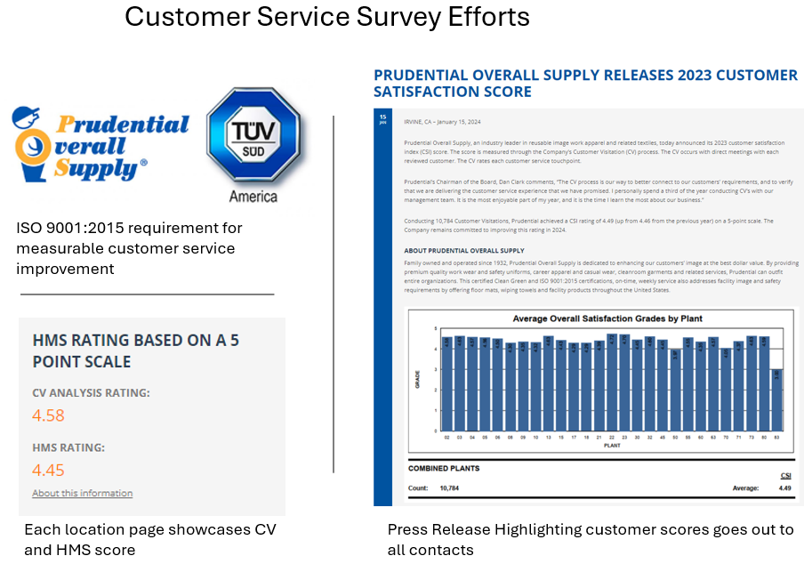

Slide 7
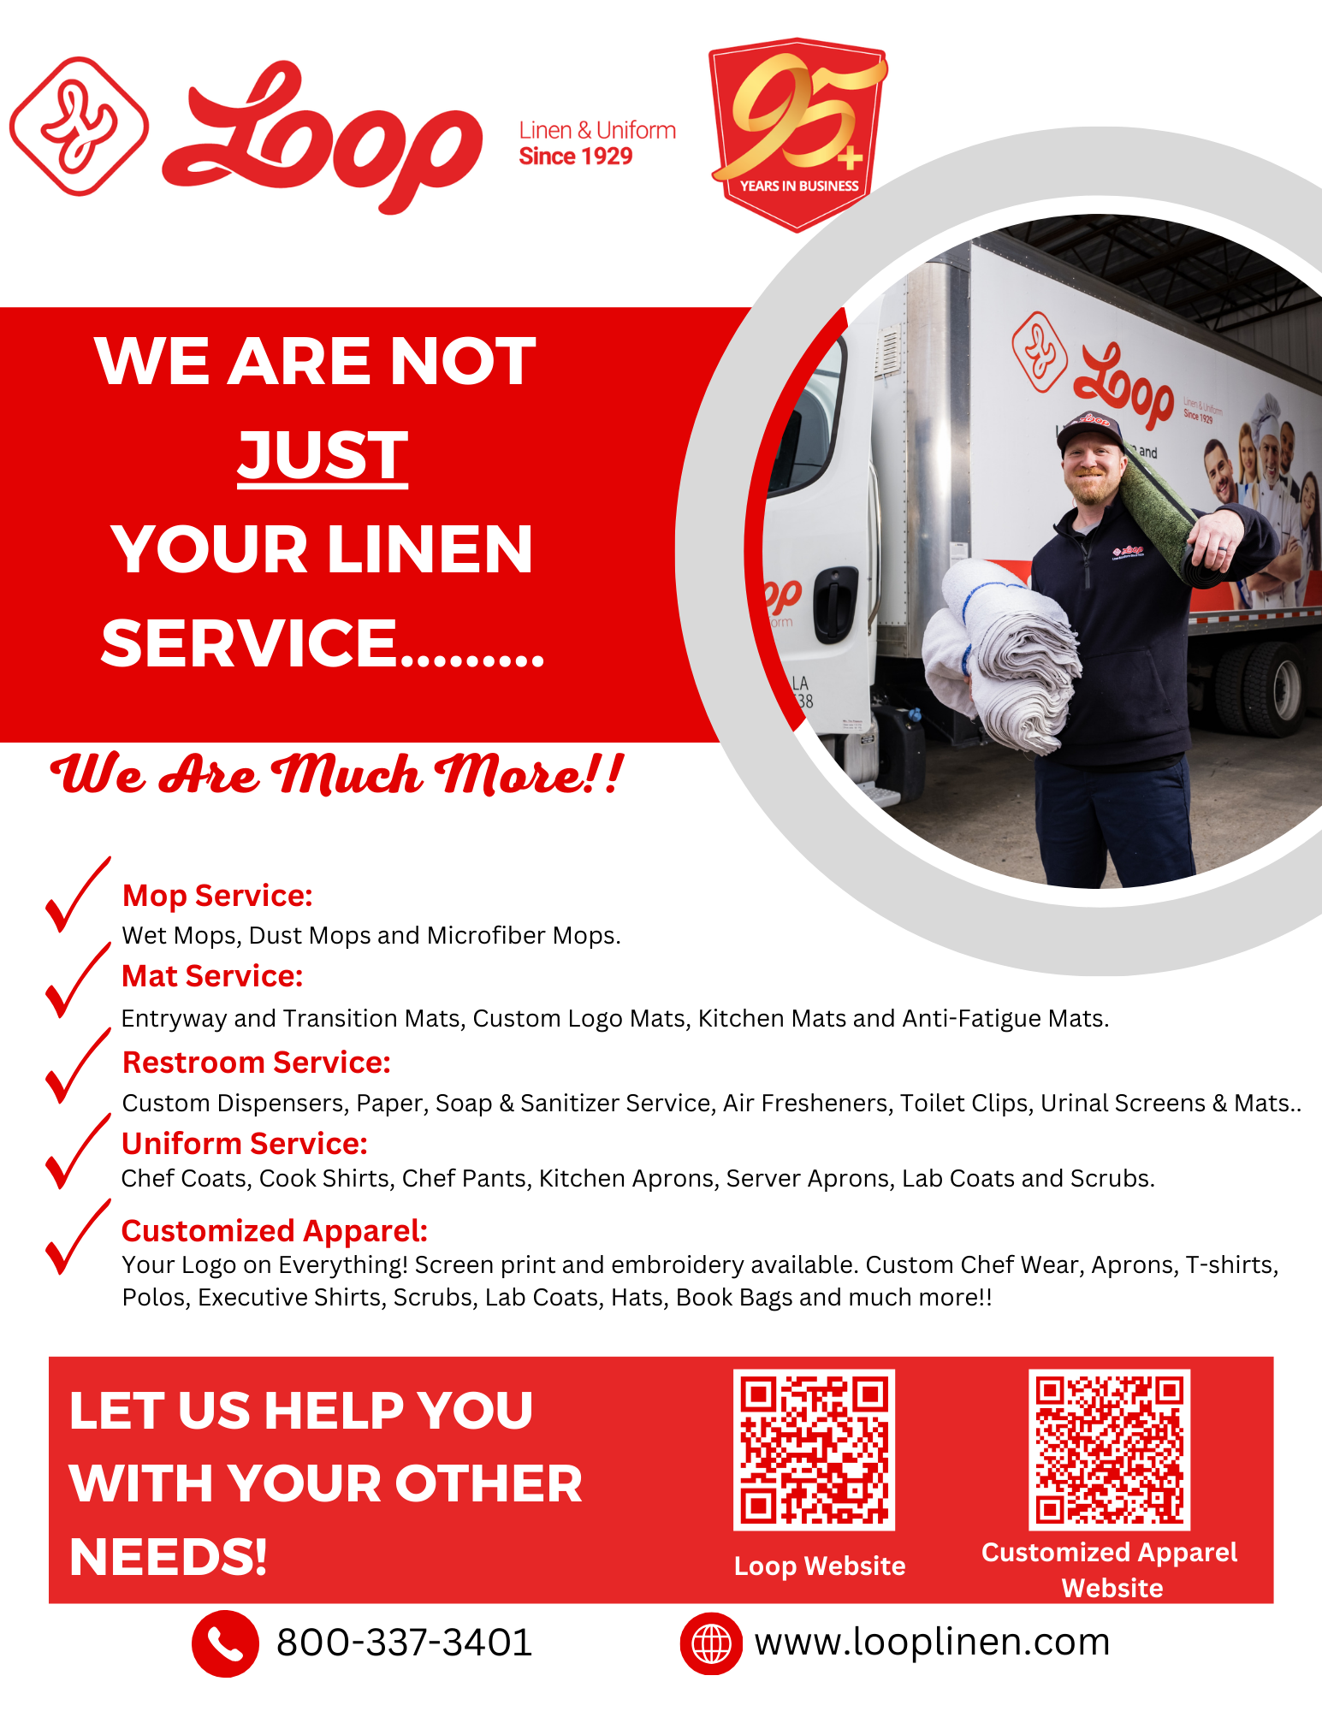

Slide 8

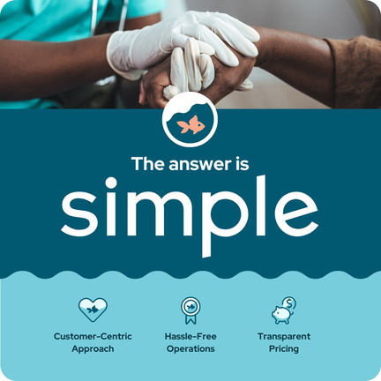
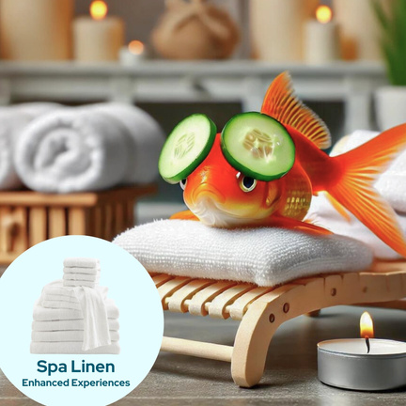

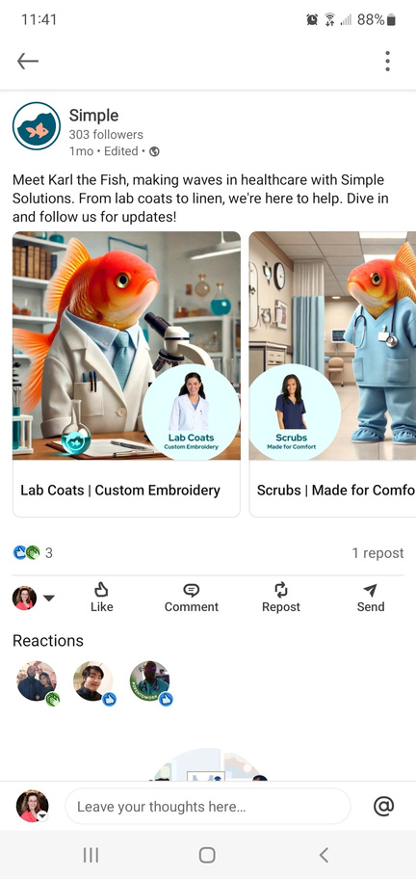
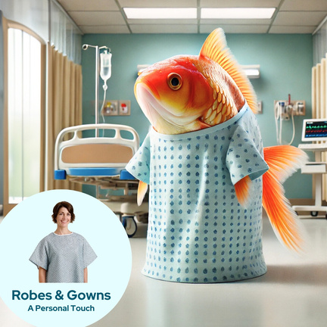
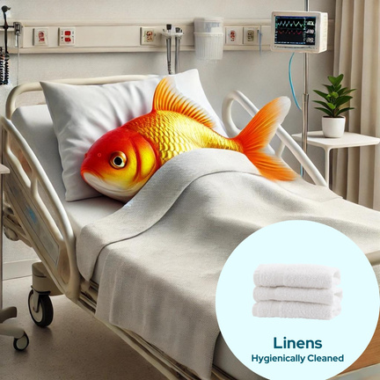
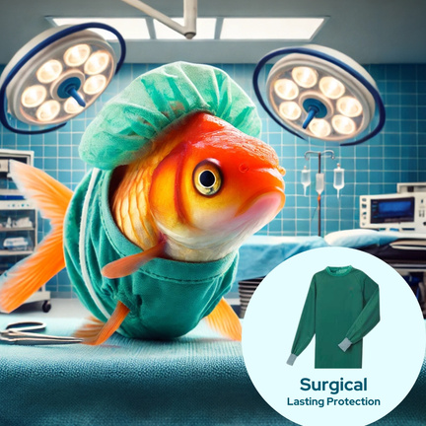
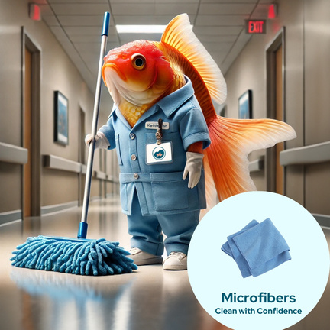
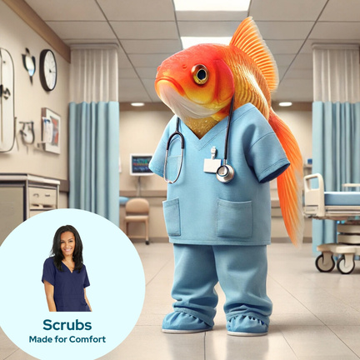
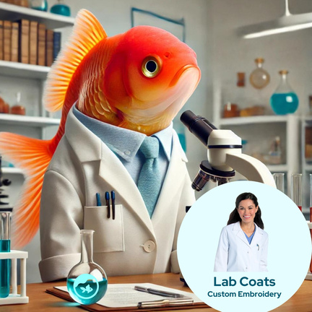

Introducing Simple
Through Karl the Fish – LinkedIn Ad
Campaign Objective:
Goal: Cost effective way to introduce Simple’s brand and product line with geographic targeting.
Approach: Feature our mascot, Karl the Fish, using AI art, to present healthcare products in an engaging way.
Why: Using AI tools allowed us to create engaging visuals and captions quickly, while still focusing on strategy and audience, cutting production time and creation costs significantly.
1.65%
59
Engagement
Rate
Total Enagement
3,586
Impressions
$3.45
$204
CPE
Total Spend
TRSA • 1800 DIAGONAL ROAD, SUITE 200, ALEXANDRIA, VA 22314 • 877-770-9274 • TRSA.ORG

Slide 9
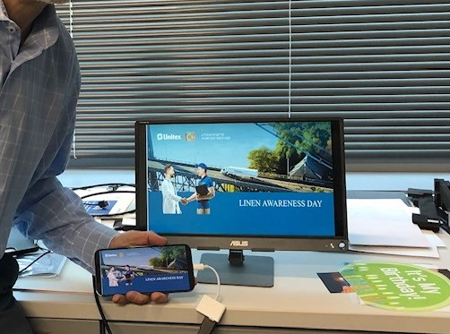
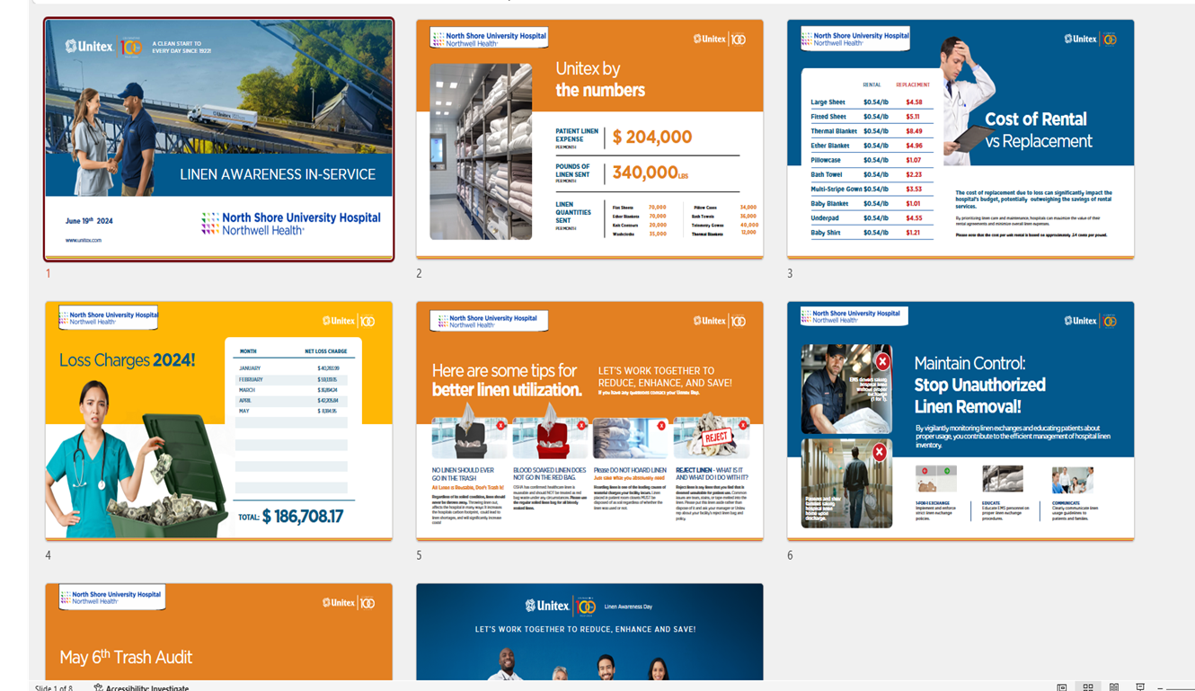
Unitex Healthcare Laundry Services – Mobile Linen Awareness Day

Slide 10
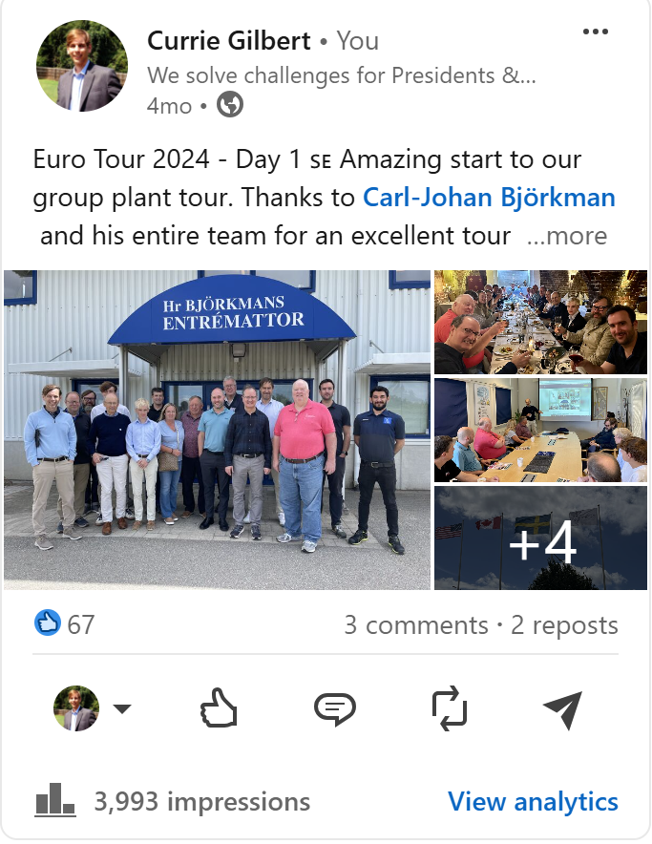
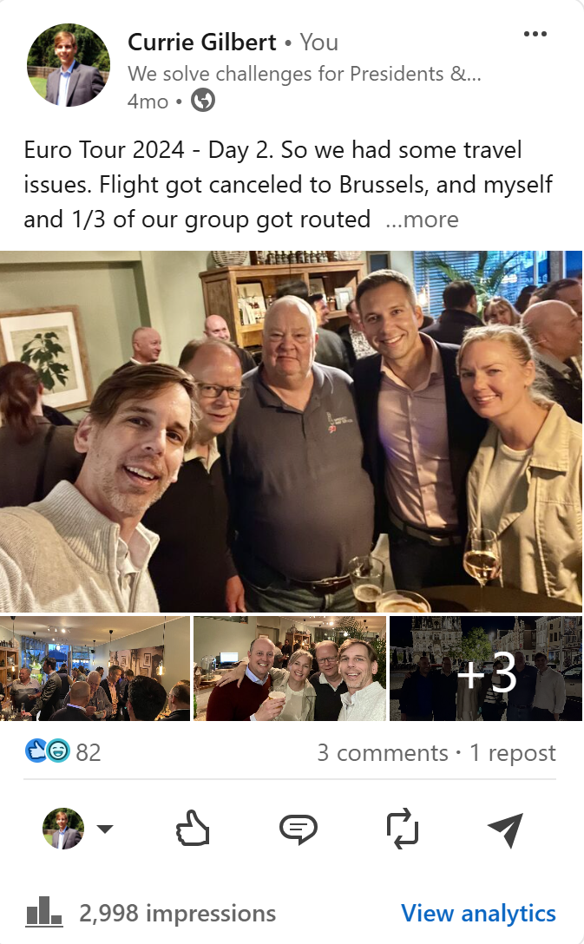
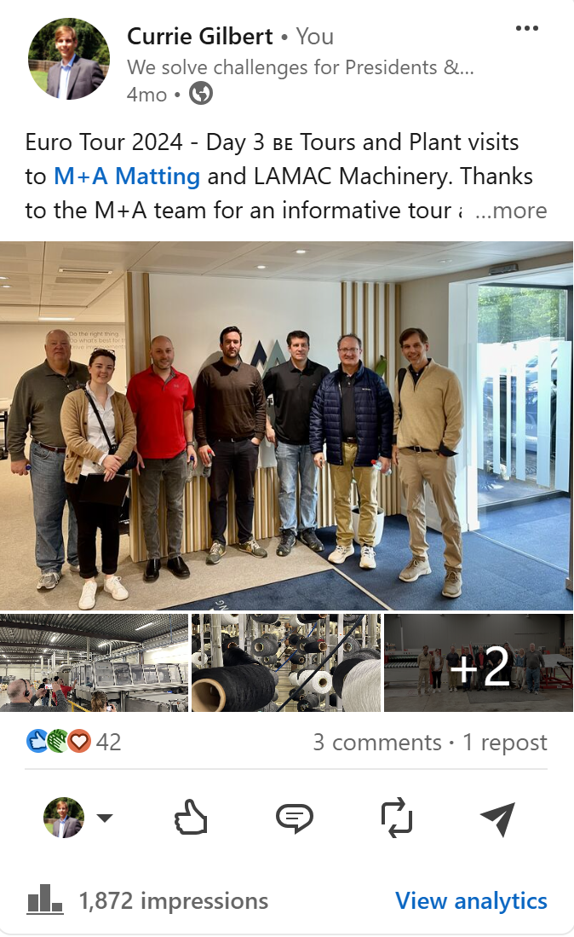
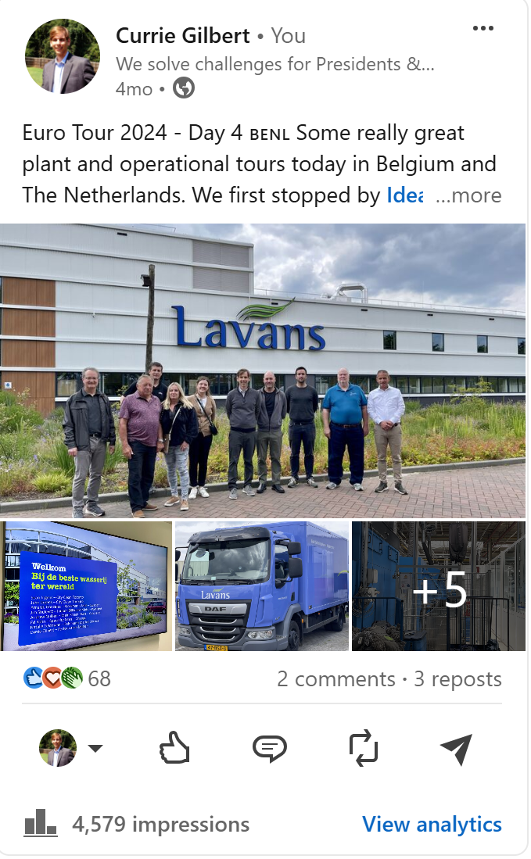
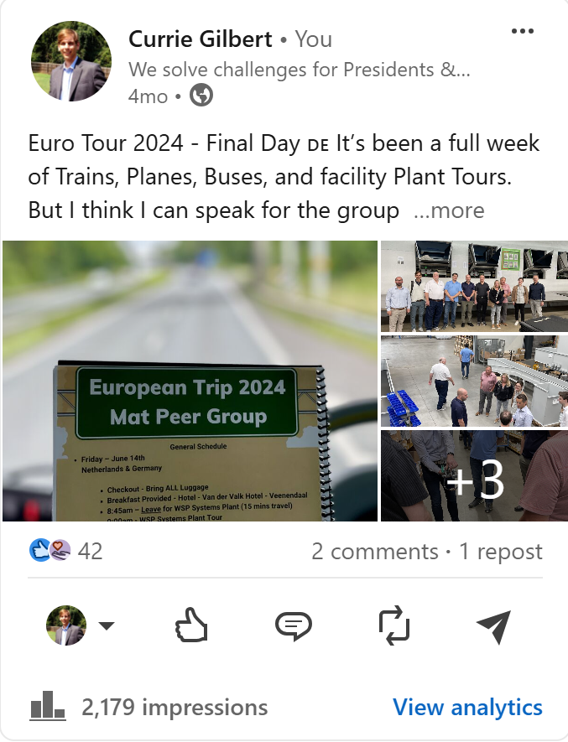
Performance Matters - Peer Strategy Group Euro 2024 Tour – Daily Trip Journal

Slide 11






WEBINARS
284
Social Media
Registrations
Email
195
Ads
Attendees

Slide 12
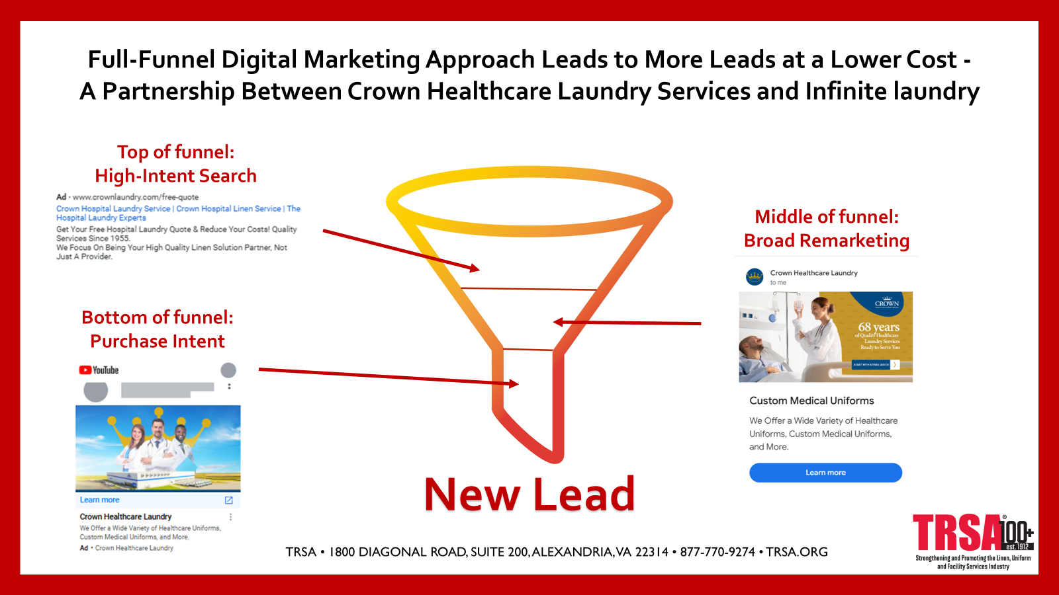
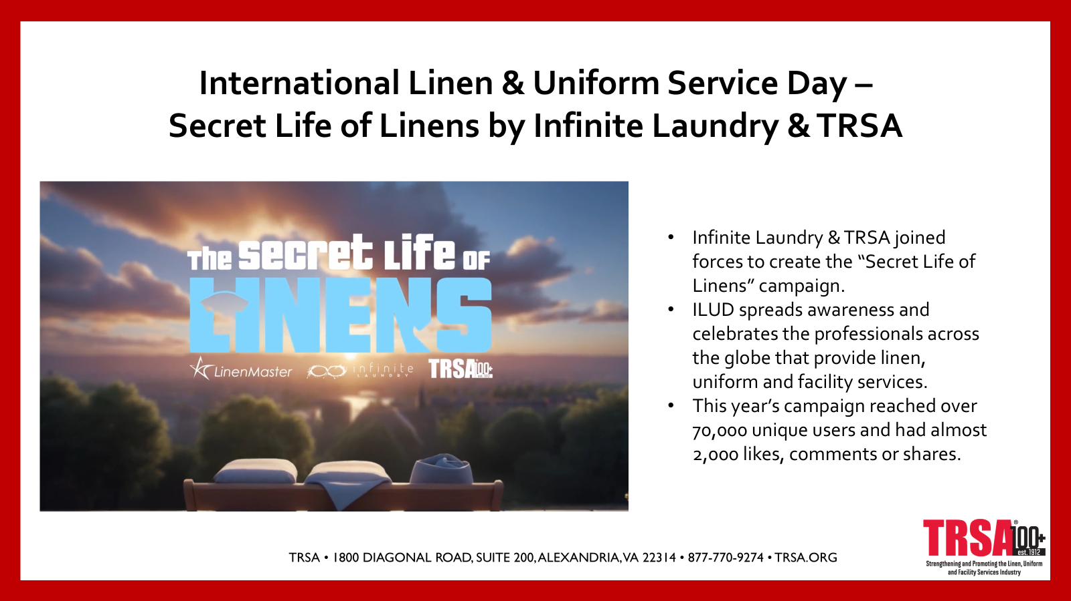
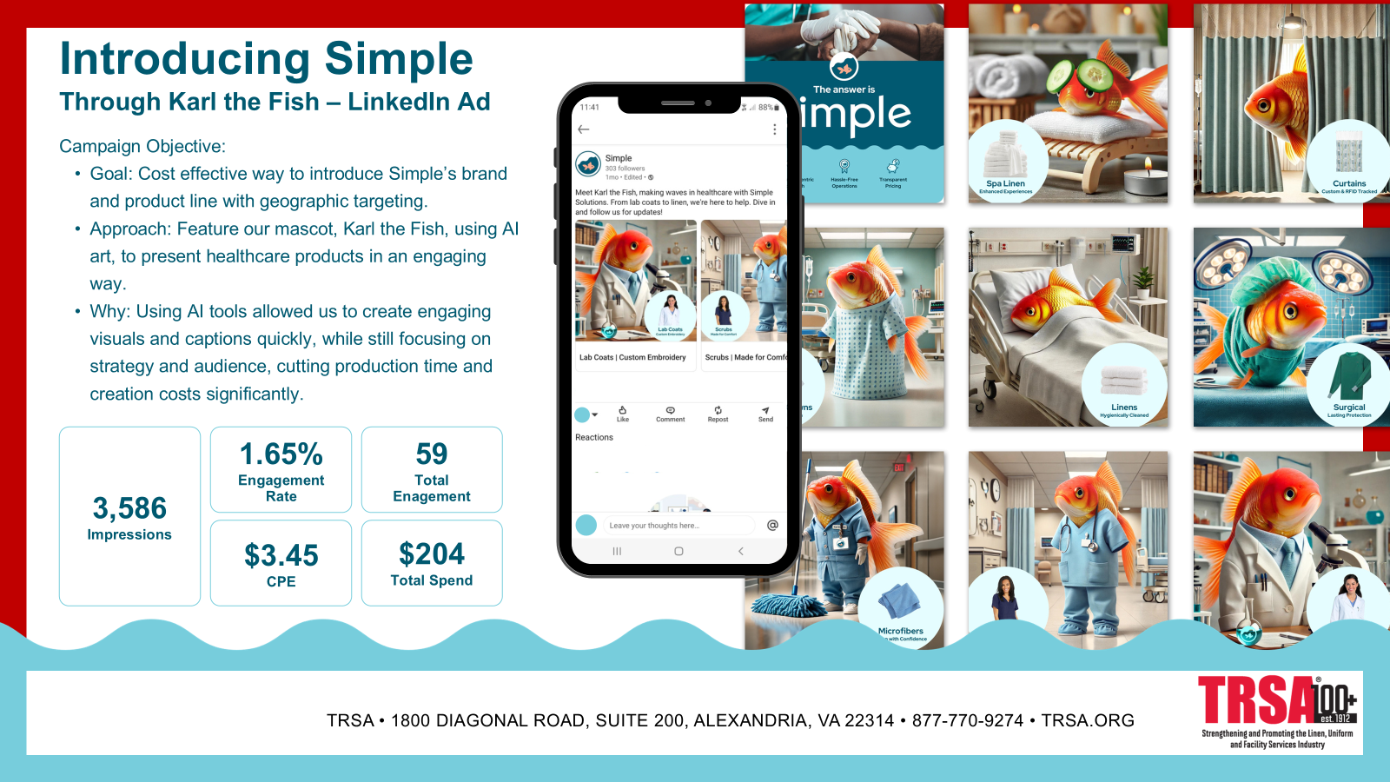
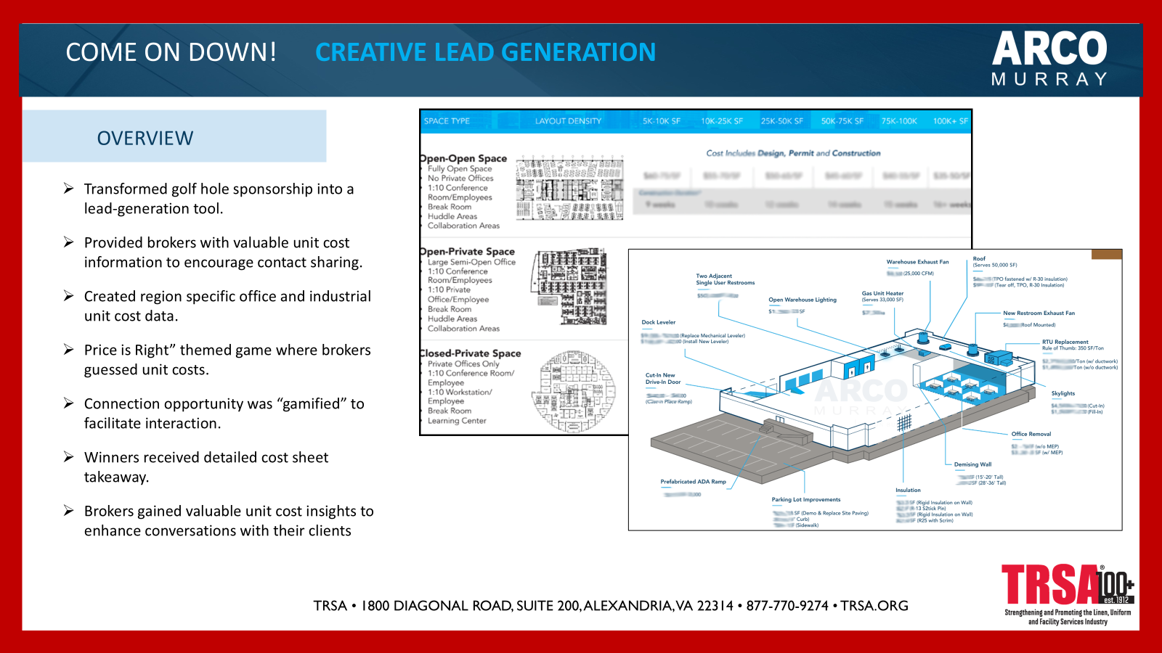
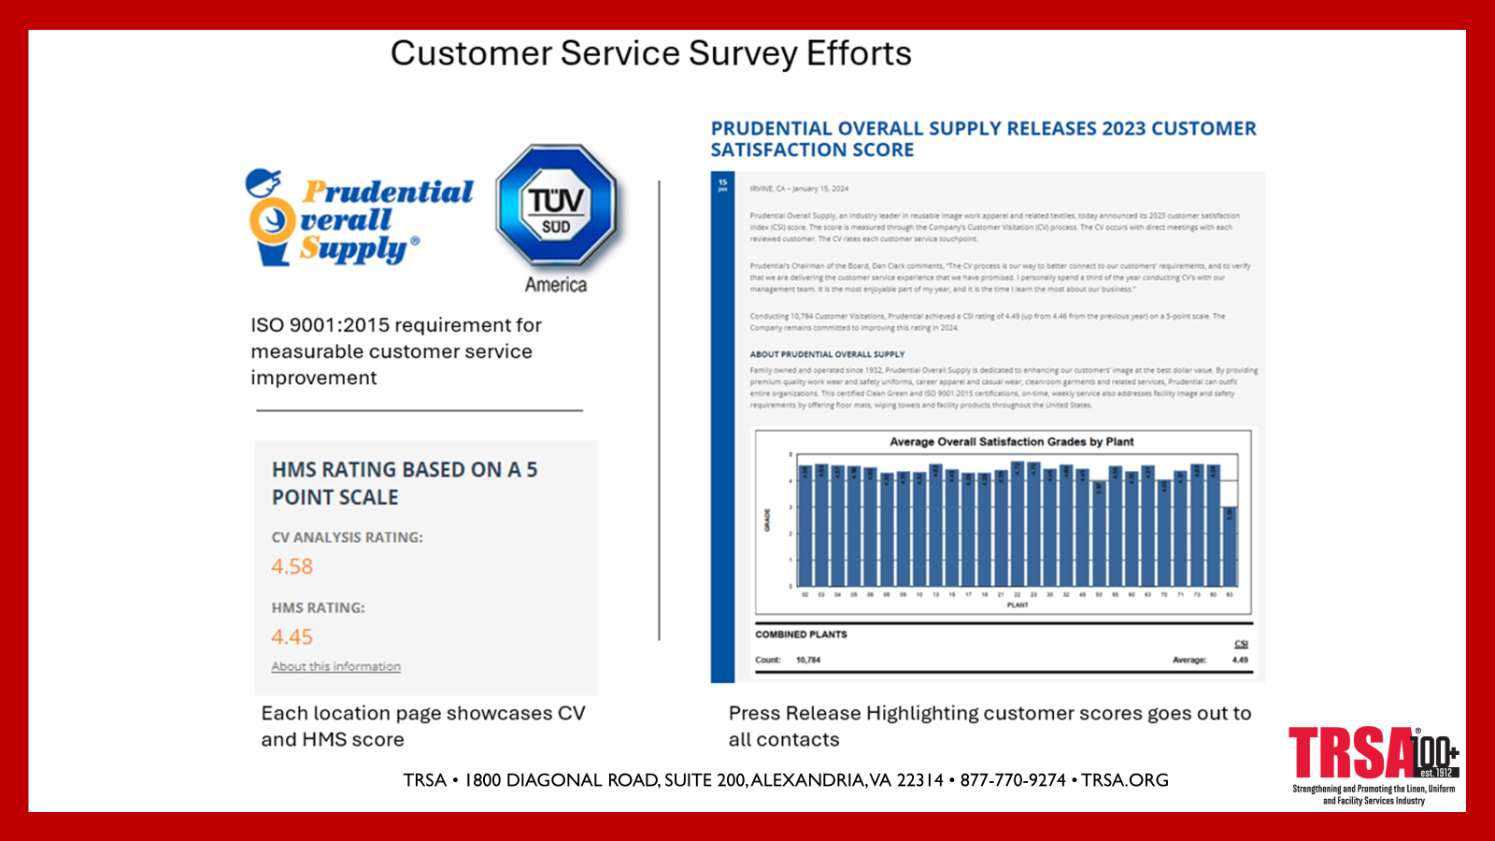
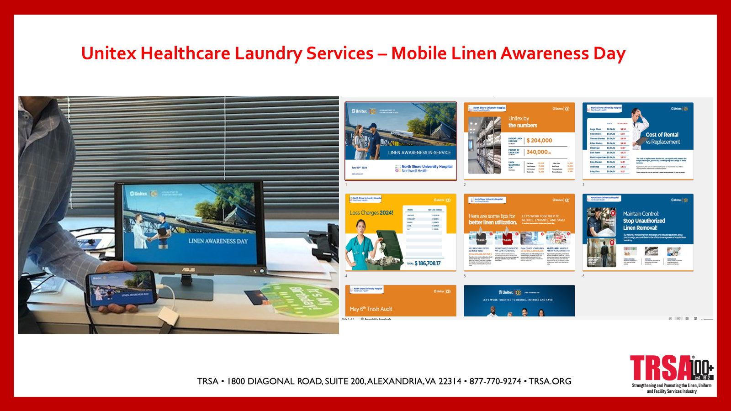

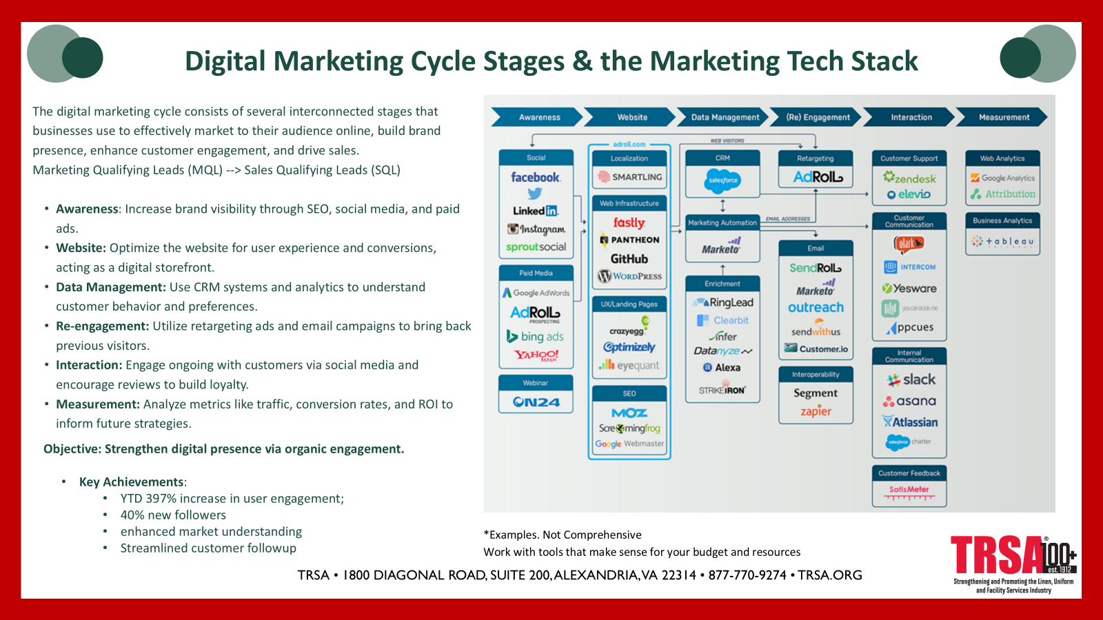
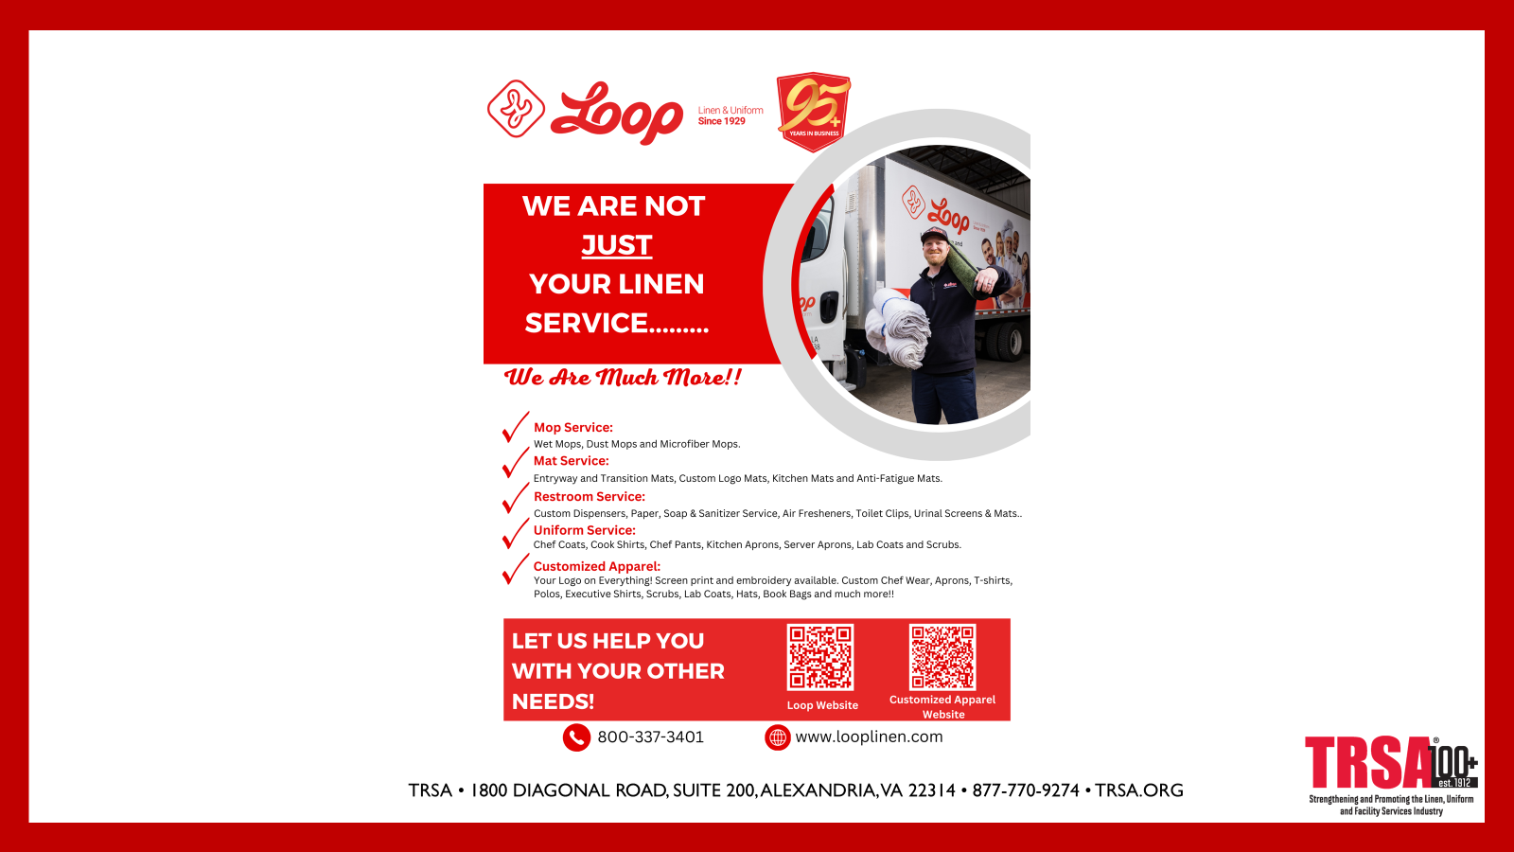
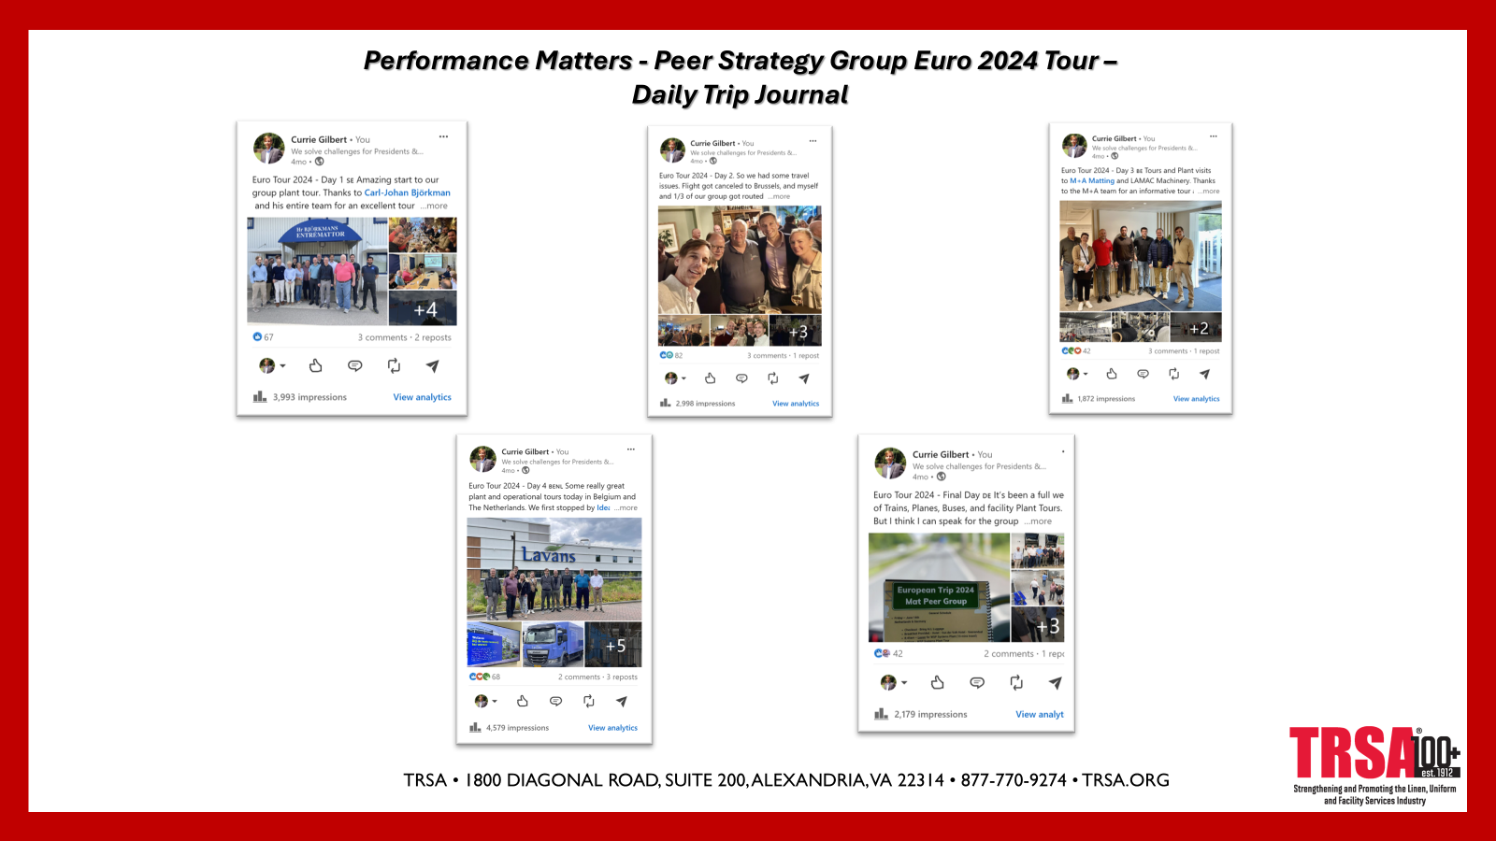
Cast Your Vote!
1
4
7
2
5
8
10
3
6
9

Slide 13

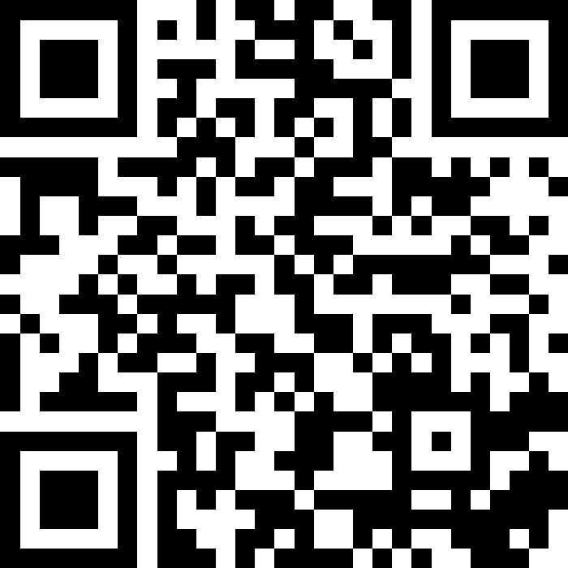
Join at slido.com #5663767
ⓘ Start presenting to display the joining instructions on this slide.

Slide 14

Who was best of the best?
ⓘ Start presenting to display the poll results on this slide.

