Slide 1
TRSA’s
Annual Best of the Best at
The Marketing, Sales & Service Summit

Slide 2

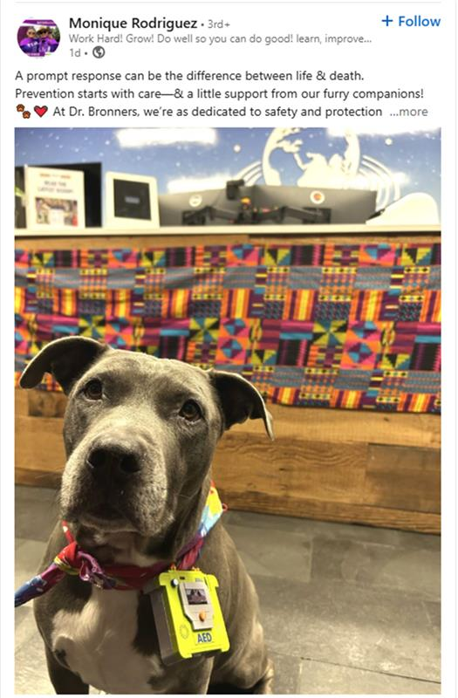
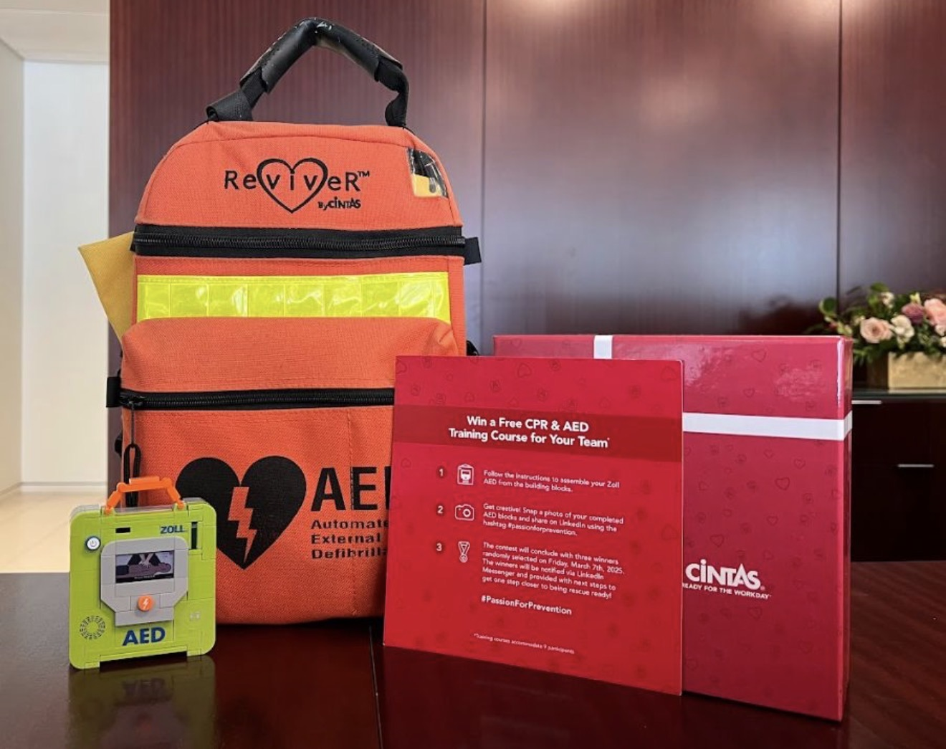


Division: First Aid & Safety
Goal: Product Services Awareness & Engagement
Outcome:
47 LinkedIn #PassionForPrevention Posts
1000+ Engagements
8 Business CPR/AED Trained
Notes:
How it worked:
FAS Division sent out Zoll Branded Building Blocks AED Set
Hand delivered to prospects
Directions to prompt recipients to post on social media with their completed AED puzzle
From those who posted 8 were selected to receive free CRP & AED Training
Results included revenue that more that paid for the campaign

Slide 3

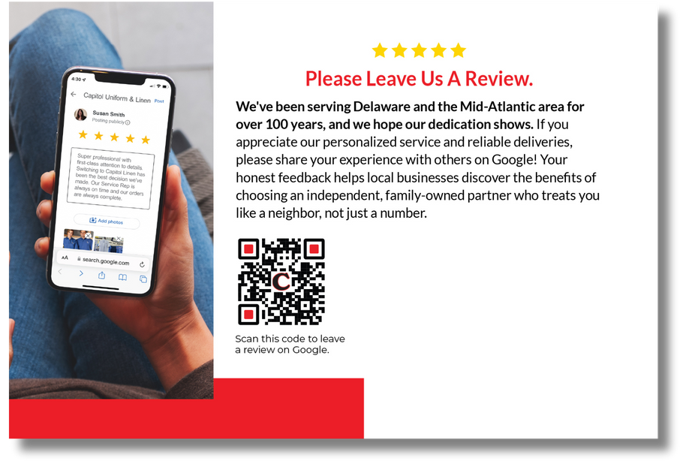






Improving Local SEO & Encouraging Google Reviews
Goal:
Increase customer reviews and engagement on Google to boost Capitol’s online presence, local SEO, and build trust with potential customers.
Strategy:
Designed printed review cards with QR codes for drivers to hand out during routes, each including a personal note to make the request more friendly. Kept the Google Business Profile regularly updated to stay fresh and maintain visibility in search results.
Front of Card
Results:
44%
557%
174%
Google Business Profile impressions increased
Volume of
reviews increased
Overall rating went from 3.3 stars to 4.6 stars
Increase in Google Search Console Impressions
Back of Card
TRSA • 1800 DIAGONAL ROAD, SUITE 200, ALEXANDRIA, VA 22314 • 877-770-9274 • TRSA.ORG

Slide 4
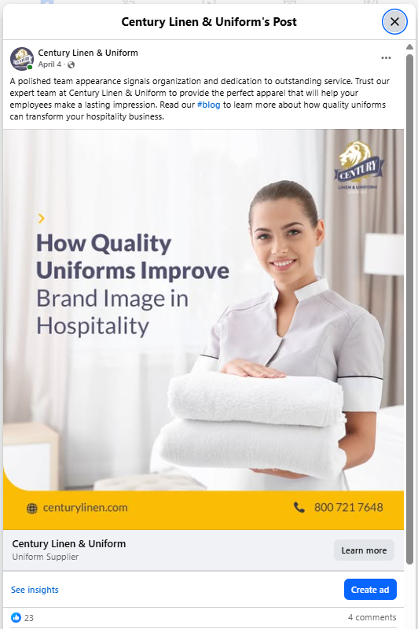
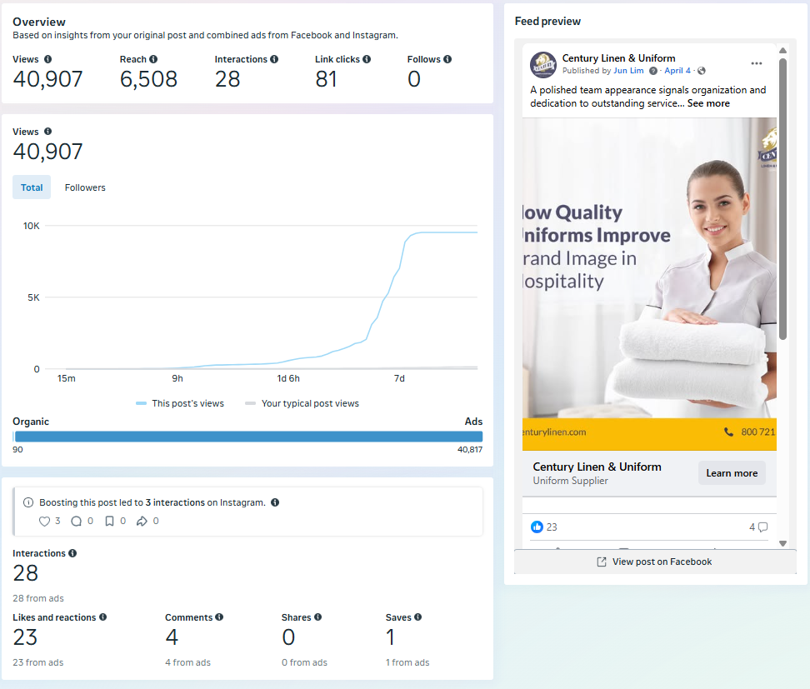

Slide 5

1
IDENTIFY IDEAL CUSTOMER PROFILE
2
RANK LEADS USING AI ALGORITHM
3
SEND MARKETING MATERIAL (EMAILS, FLYER)

Slide 6


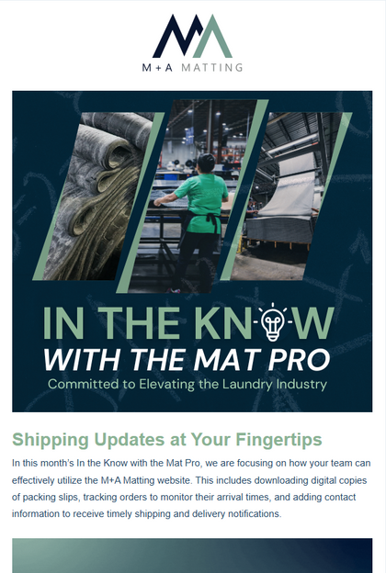
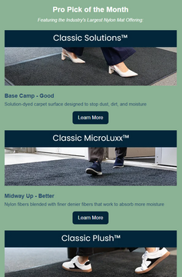


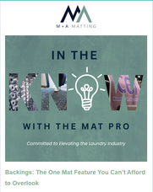

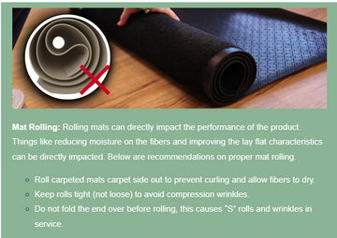



In the Know with the Mat Pro
12,265
2025 Newsletter Series for Textile Rental Customers
Total Deliveries (YTD)
Objective
Share helpful insights and updates to keep our textile rental customers informed and ahead.
Highlight new solutions and success stories to help laundries win on their customers’ floors.
Provide tips and tools that support operational excellence and profitability in the plant.
Approach
Branded, same-time monthly newsletter format.
Each issue solved one operator task (shipping, mat storage, lease & leave, post-wash care).
Always linked back to mamatting.com or a how-to resource.
Why it worked
Operations-first topics gained the highest opens.
Consistent look-built trust.
Content was usable by the field right away.
28.6%
Avg Open Rate
Industry avg 17.3%
9-10%
CTR on top issues
Industry avg 2.6%
Monthly
Frequency
April ’Shipping Updates’
33% open rate
Best performer
TRSA • 1800 DIAGONAL ROAD, SUITE 200, ALEXANDRIA, VA 22314 • 877-770-9274 • TRSA.ORG

Slide 7
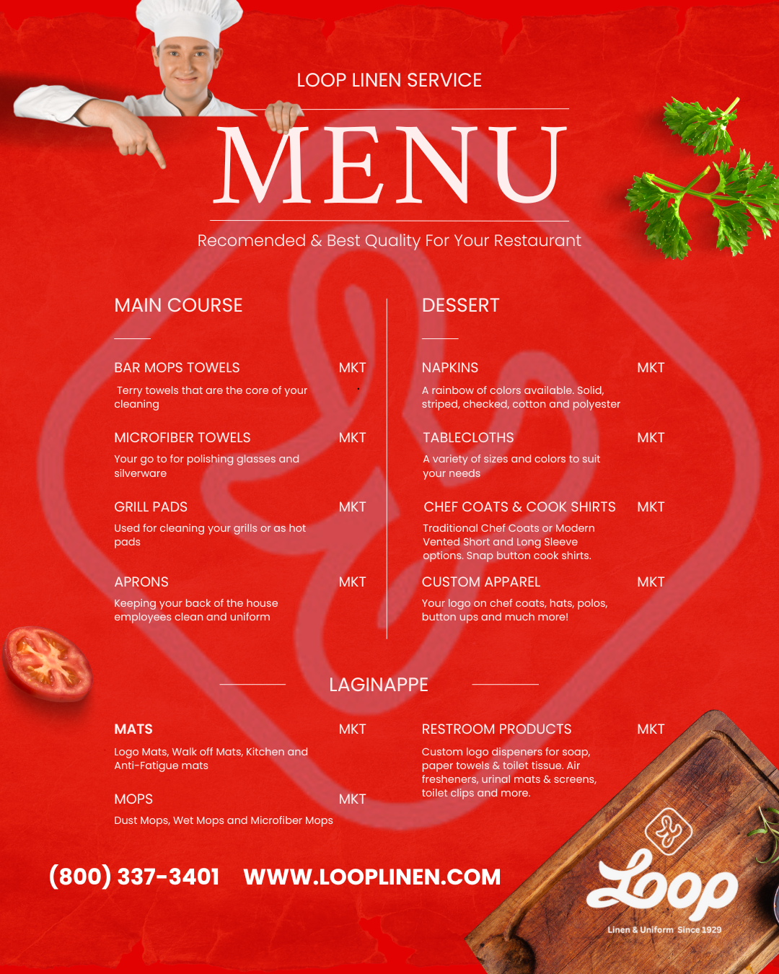

Best of the Best: Food & Beverage Social Media Post
This social media post was created for our Food & Beverage customers.
The design mimics a restaurant menu, showcasing our linen offerings tailored for F&B establishments.
The post performed exceptionally well across all social platforms, generating strong engagement, multiple shares, and an increase in new followers.

Slide 8
TRSA’s
Annual Best of the Best at
The Marketing, Sales & Service Summit

Slide 9




PARTNERSHIP CLEAN SWEEP BEHIND THE COURT
Clean Sweep - Behind the Court presented by Alsco Uniforms offered an intimate glimpse into the hard work of the 76ers Mop Crew. The episode highlighted their deep passion for the sport, the camaraderie among the crew, and their pride in their vital role. The content was posted on sixers official Instagram, Facebook, and X as well as paid social.
177K Impressions
5.8K Engagements
Paid Campaign: 1.9M Impressions
Paid Campaign:
.47% CTR

Slide 10
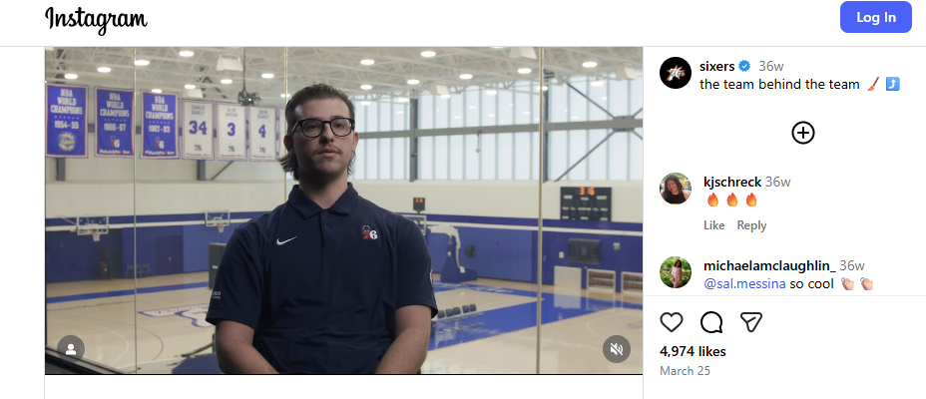
Alsco Uniforms 76 ers Instagram

Slide 11

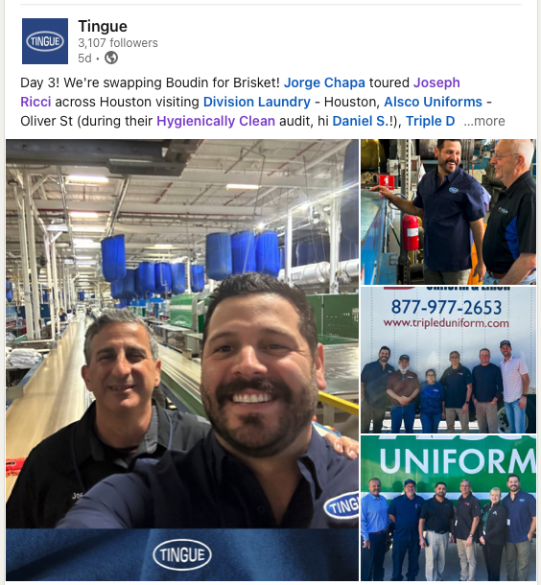
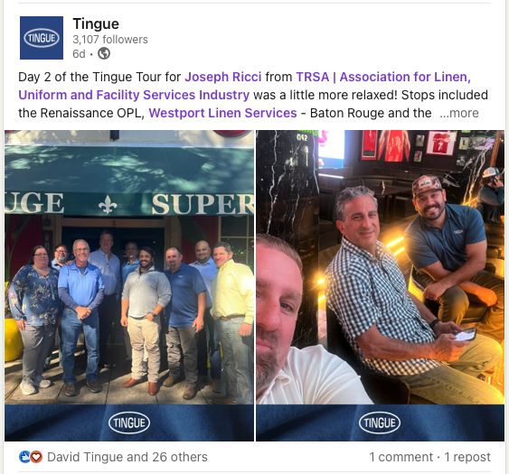
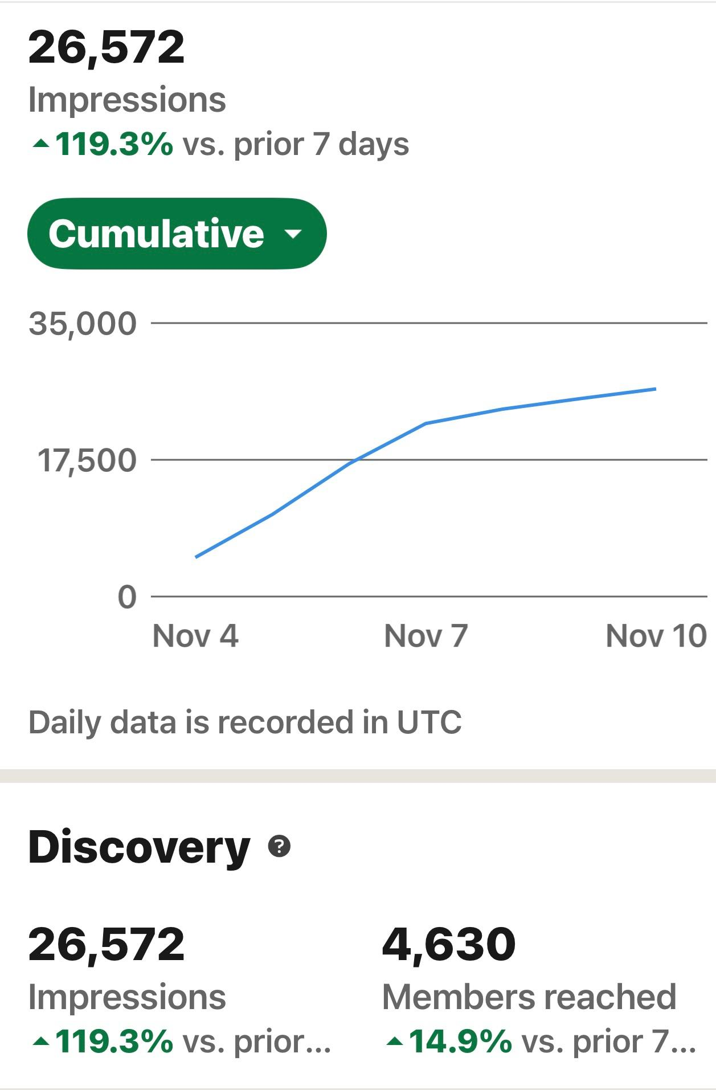
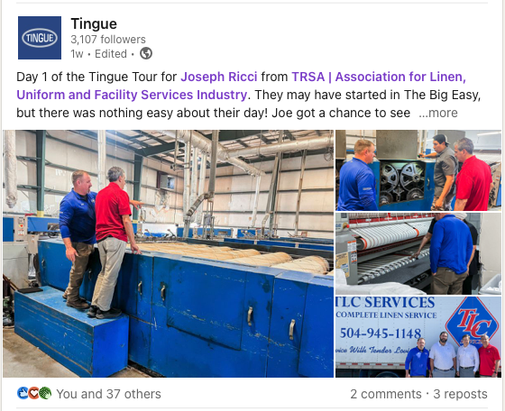

Joe Ricci – Louisiana and Texas “Ride Along”
Trip donated for the TRSA Foundation Silent Auction

Slide 12
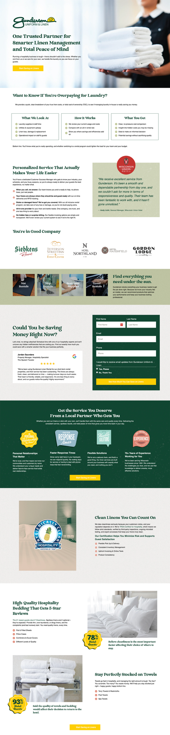



WHLA Hospitality Linen Campaign:
Simplifying Operations for Wisconsin Hotels
Goal:
Increase visibility and leads for Gunderson Linen’s hospitality division by reaching hotel & lodging GMs through WHLA’s digital network.
Strategy:
3-month WHLA newsletter campaign testing message and creative themes - from ‘Get your free linen cost analysis’ to ‘Start saving on linens’ - to drive traffic and conversions on a dedicated landing page.
Results:
Newsletter
Banner
+300%
700+
500+
Increase in conversion rate. (0.5% to 2%)
Landing page visits
Impressions in Google Search Results
Landing Page
TRSA • 1800 DIAGONAL ROAD, SUITE 200, ALEXANDRIA, VA 22314 • 877-770-9274 • TRSA.ORG

Slide 13

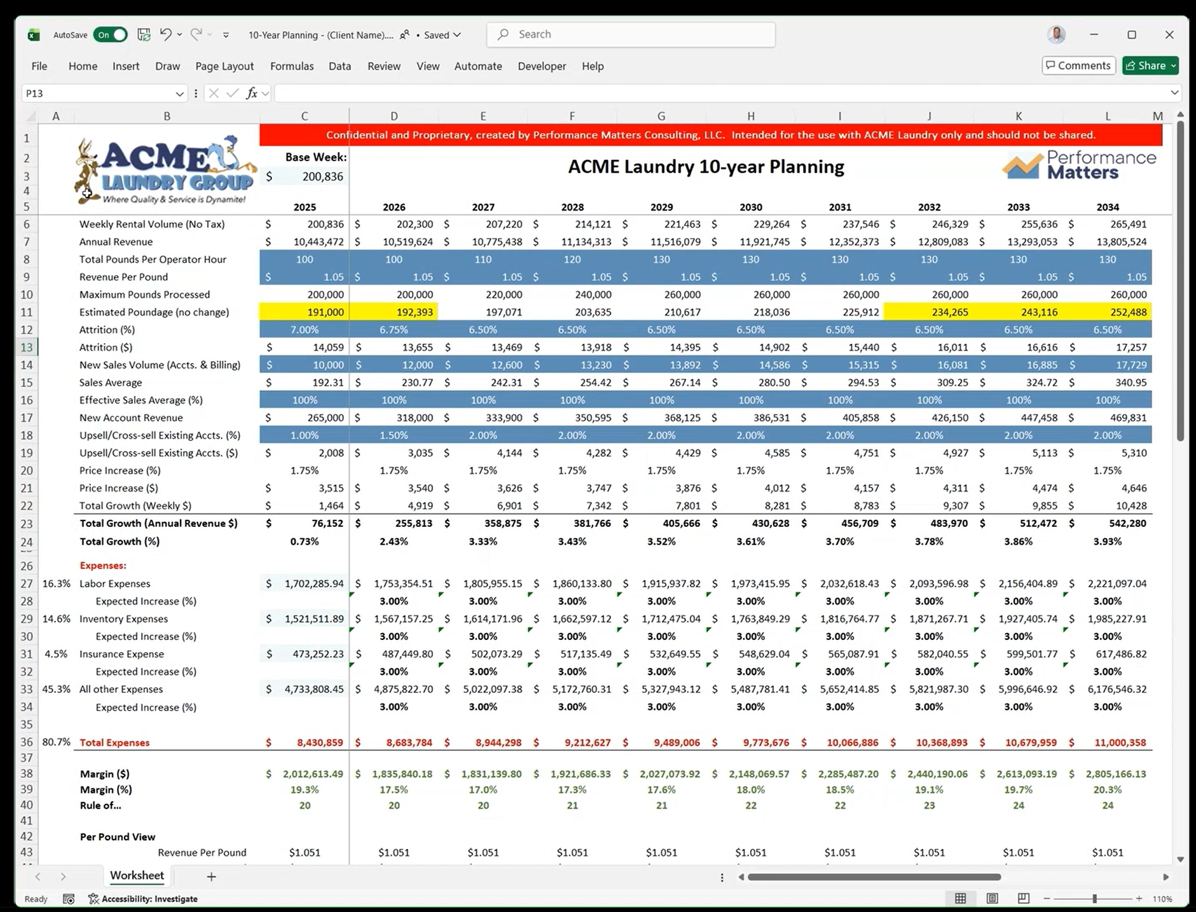
Cheat Code for Commercial Laundry
Are you growing your revenue per pound at a rate that covers your cost per pound increases?
Trend Analysis: The model enables GMs/Owners to observe whether the margin gap between RPP and CPP is shrinking or growing over time.
Decision Impact: It allows users to see how specific business decisions affect both revenue and cost per pound, providing clarity on financial outcomes.
Comprehensive Cost Tracking: The system accounts for various cost drivers such as labor, inventory, insurance, and other expenses, ensuring a holistic view of financial performance.
Revenue Strategy Evaluation: The model highlights that net price increase strategies, including attrition and new account sales, may not fully offset rising costs, prompting a need for more strategic planning.
Data-Driven Insights: By moving beyond gut feel, the forecasting tool supports strategic planning with concrete data, helping Industry Leaders make informed decisions.

Slide 14
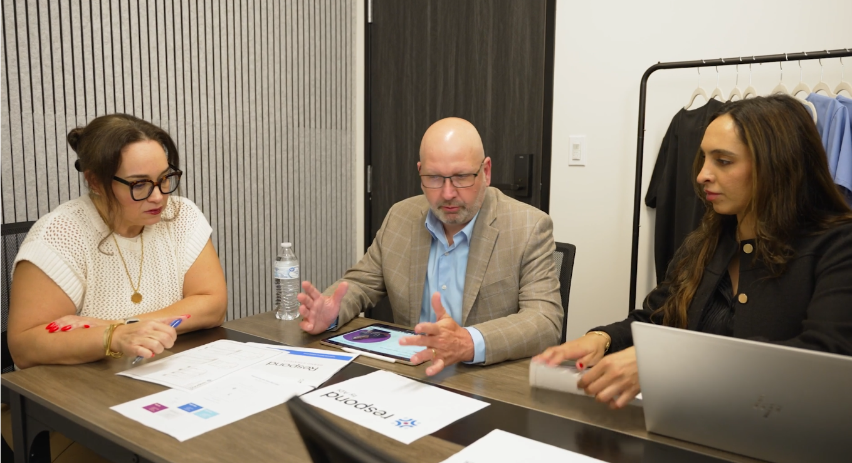

American Dawn Inc (ADI)
Respond by ADI
This video is our Brand Story video for Respond by ADI, ADI’s latest product launch – premium scrubs.
Click here for the video.

Slide 15
TRSA’s
Annual Best of the Best at
The Marketing, Sales & Service Summit

Slide 16
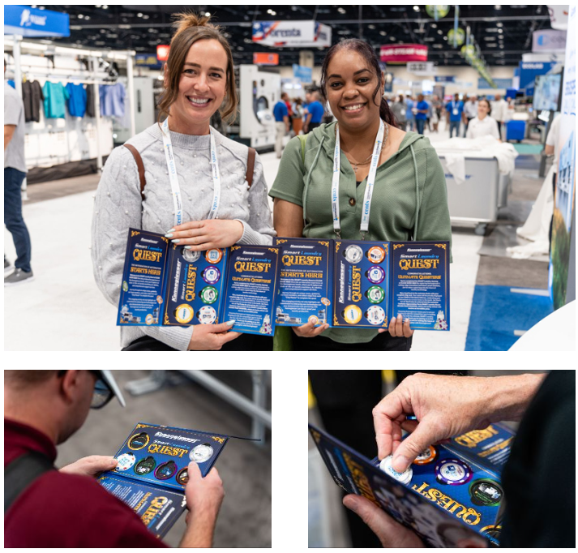

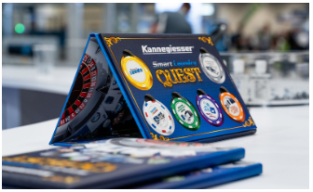
Gamifying Engagement:
How SMART Laundry Quest Drove Interaction and Learning at Our CLEAN Show Booth
📊 Attendees at the CLEAN SHOW Breakdown:
Day 1 – Aug 23: 83 attendees
Day 2 – Aug 24: 70 attendees
Day 3 – Aug 25: 36 attendees
Day 4 – Aug 26: 26 attendees
-------------------------------------
🎯 Grand Total: 215 attendees

Slide 17
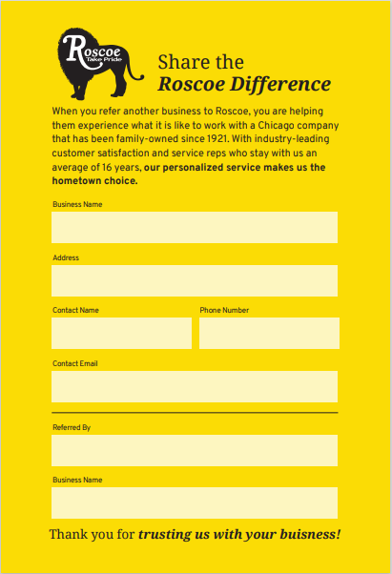

Slide 18

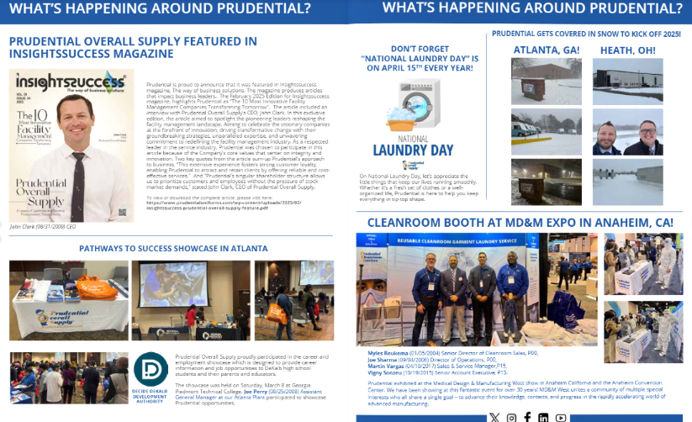
Emailed out to email list
Given to customers and prospects
Shared internally
Gives insight into the Prudential Family

Slide 19

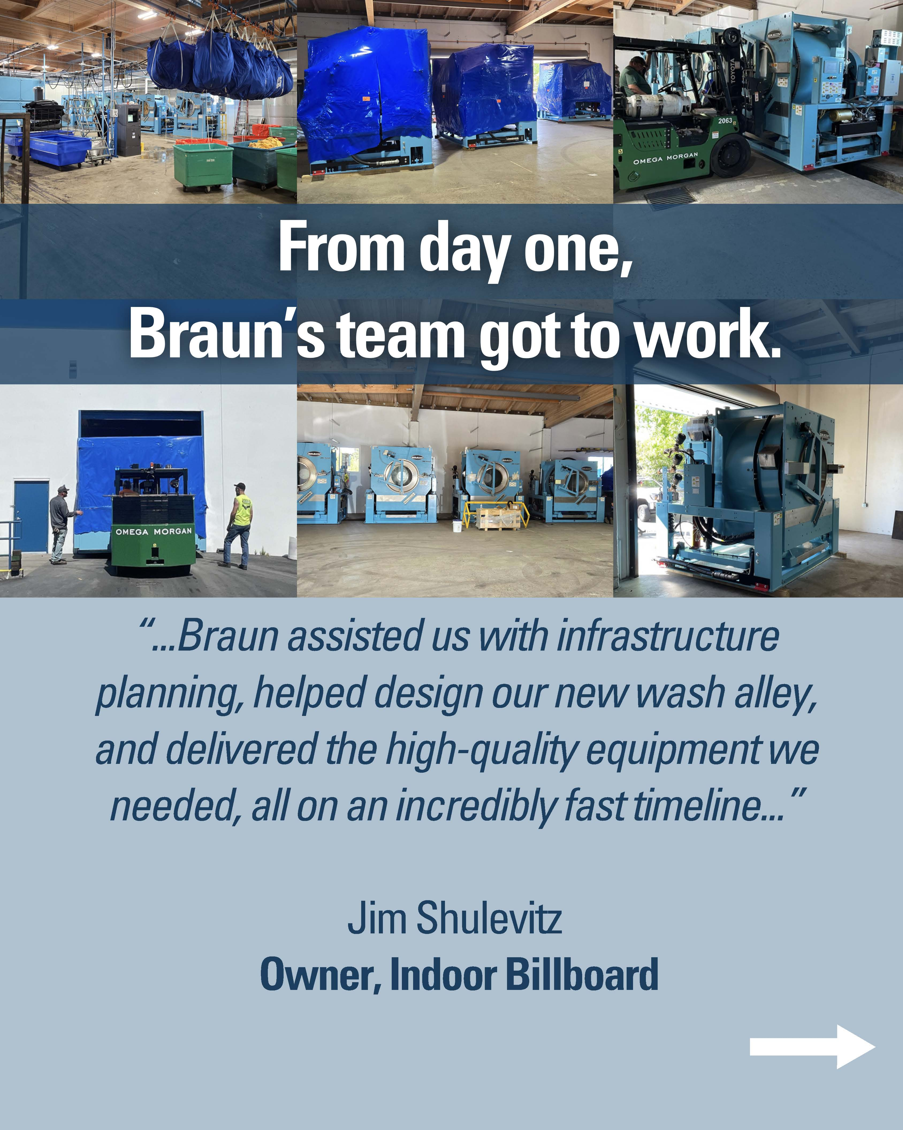
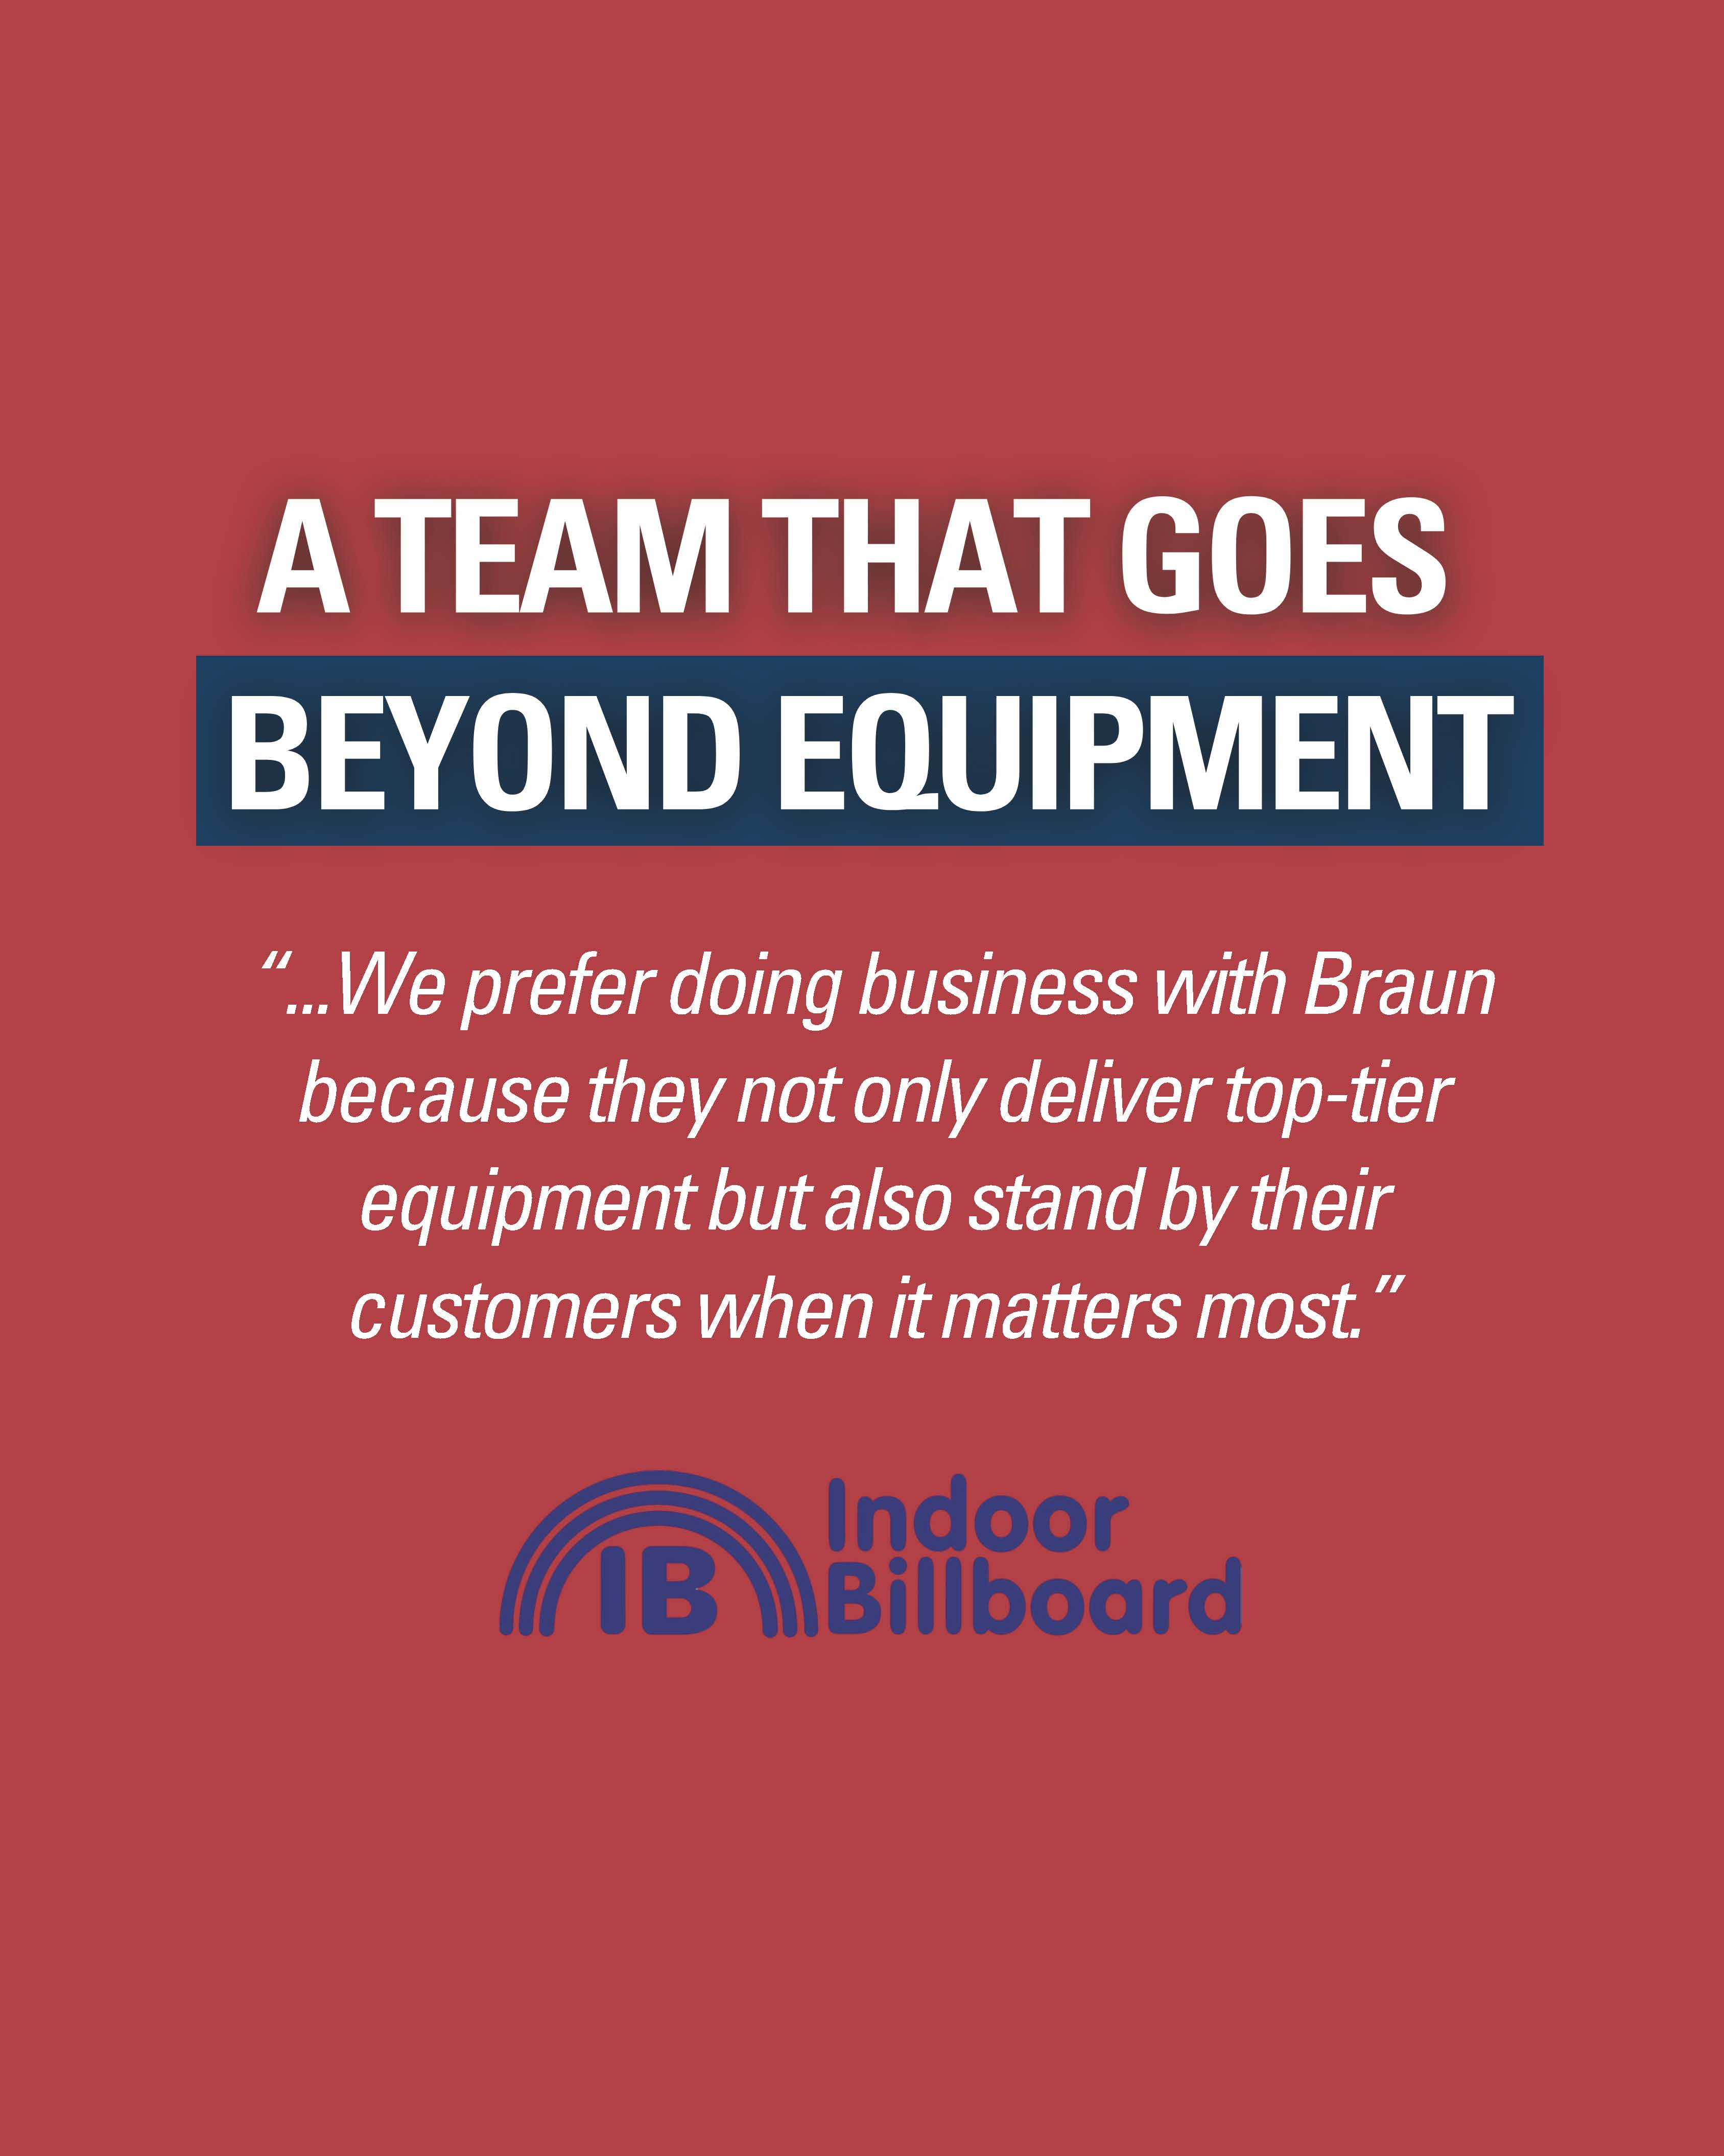
🗣️ Customer Testimonials Your most powerful marketing asset
Notes:
After a devastating fire destroyed a customer’s laundry facility, Braun® partnered with them to rebuild from the ground up.
Our goal was simple — to tell their story of resilience, and to show how Braun’s people — not just our equipment — helped them recover operations and come back stronger than ever.
The campaign highlighted Braun’s long-term partnership, hands-on project management, and our commitment to stand by customers through every challenge.
What made this campaign special is that it was a true team effort. Our sales team captured the photo and video content in the field, proving that anyone — in service, sales, or support — can play a role in marketing.
The testimonial became one of our most-shared pieces of content of the year — driving engagement across LinkedIn, our website, and print. More importantly, it reminded our industry that Braun is more than machines — we’re partners who help rebuild when it matters most.

Slide 20



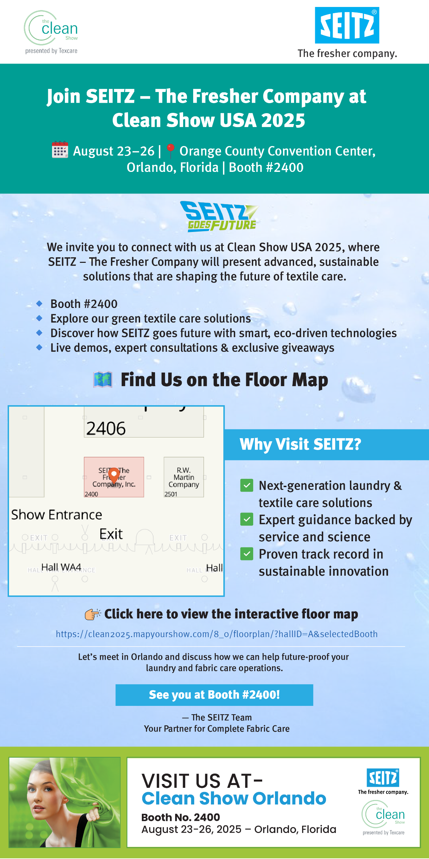

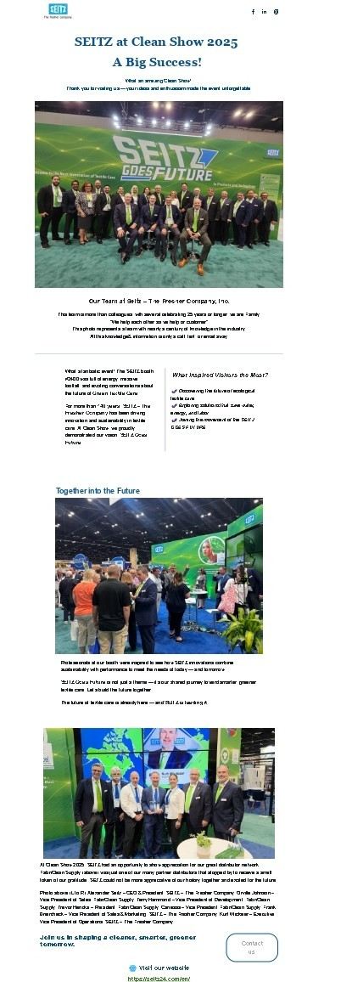
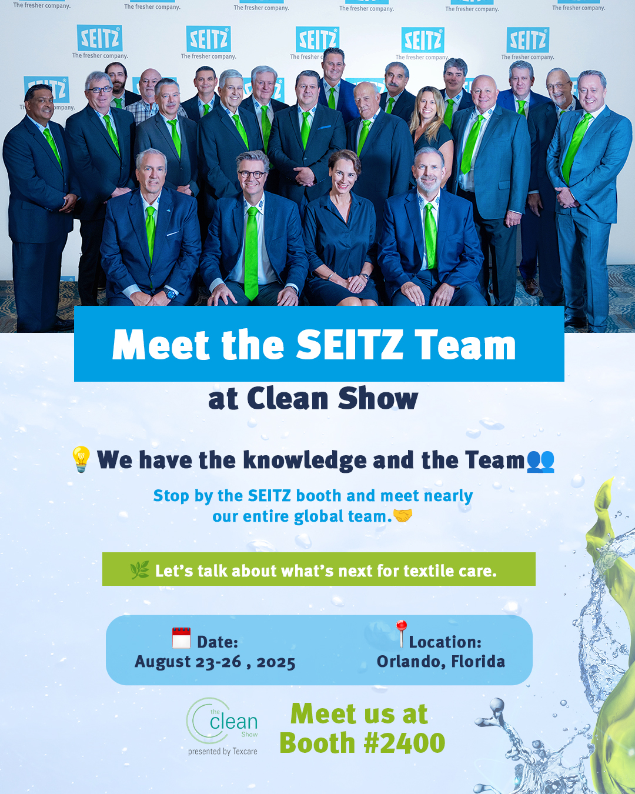


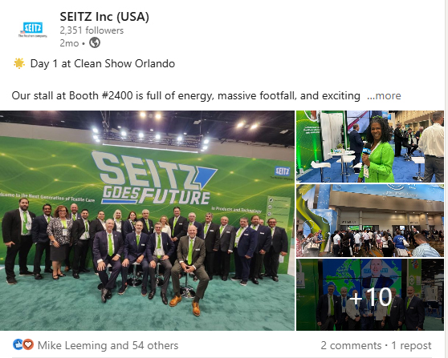


OUR THEME : SEITZ GOES FUTURE
Email Campaign Overall Analysis
Social Media Campaign Overall Analysis
Invitees : 3,315
Opened : 29.13% Clicked : 6.31%
Booth scans: 218
% of booth visitors were invitees : 15% % of invitees visited booth :1%
Impression : 5,360
Engagement :23.2%
Clicks : 1,223
Matches: 33

Slide 21
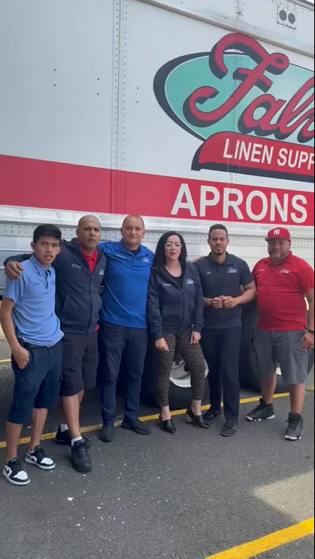

falvey

Slide 22
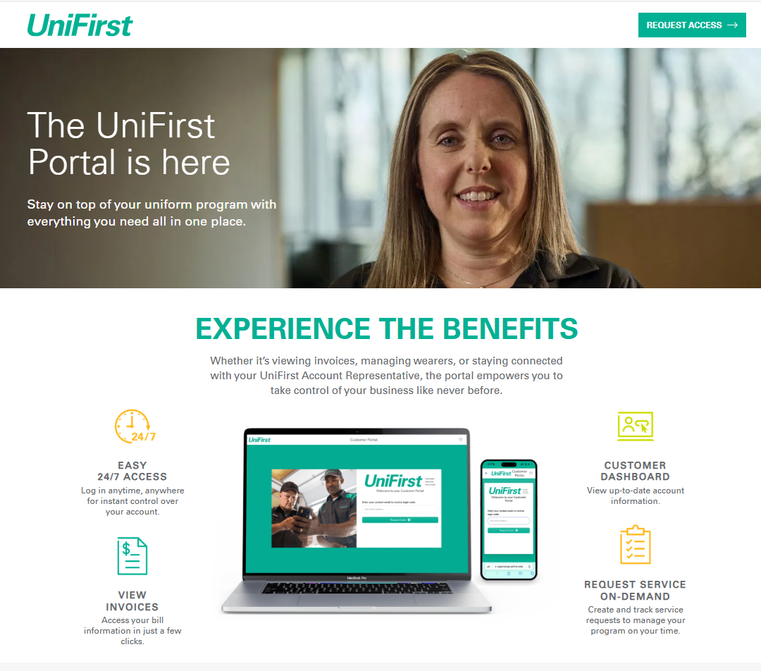
9 Months of Roll Out (Dec 24 – August 25)
68K ship-to locations enrolled
50K unique portal users
21K service requests created to date
Wearer management is a key feature

Slide 23



Do not edit How to change the design
Join at slido.com #5438387
The Slido app must be installed on every computer you’re presenting from

Slide 24

Do not edit How to change the design
Who is 2026's Best of the Best
The Slido app must be installed on every computer you’re presenting from

