Slide 1


Slide 2
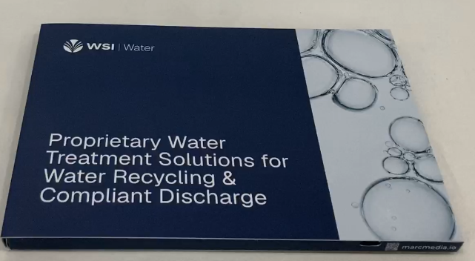
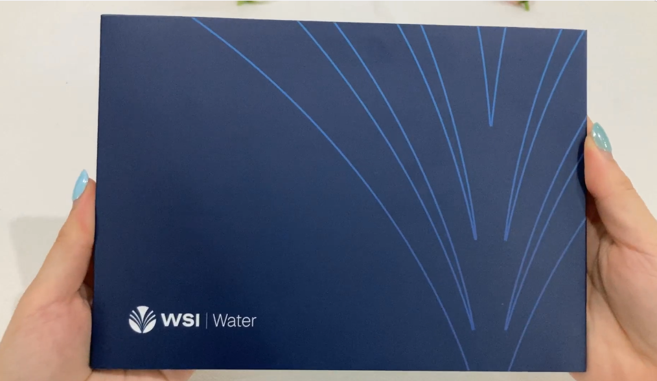
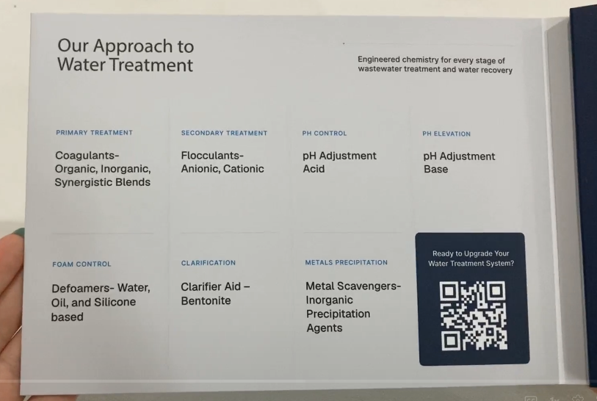
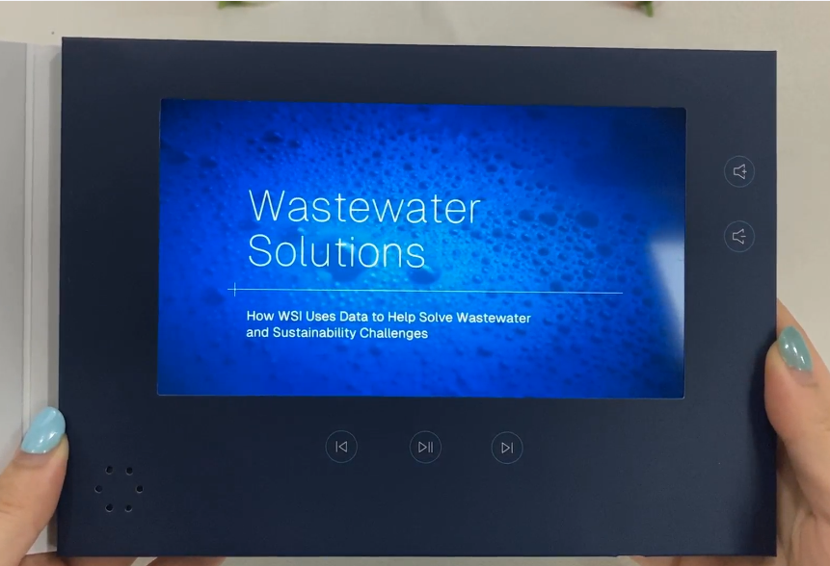
Interactive Direct Mail Campaign: WSI Water
Front
Features & Benefits:
88% Open Rate
239 Engagements (3.62 average per person)
3:34:42 of total play time
Duration ~40 Days
6 Accounts in active-decision phase/8 Accounts still in consideration
Forecasted ROI (using estimates from 6 active-decision):
ROI: 4,177%
Return Multiple: 42.8x
Impact:
Combines digital, print and video
In-depth, user-level analytics in real time
Custom dashboard for each campaign
14 QR scans; 23.5% engagement rate
Back
Inside left panel and video screen

Slide 3
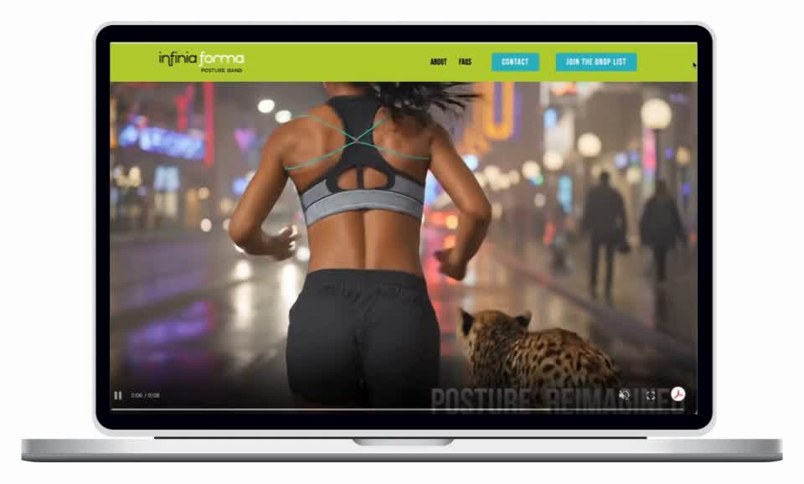






TURNING AN ESTABLISHED BRAND VISION INTO A SALES-READY WEBSITE
Goal:
Create a premium website that brought Infinia Forma’s existing brand assets and content together in a cohesive way, while meeting a fast-approaching deadline for national retail sales conversations.
Approach:
RED66’s creative and web teams took the supplied brand direction further, refining the visual experience, organizing the content and building a polished website that better reflected the quality of the Infinia Forma brand.
Results
Website developed and launched in just 5 weeks
Ready in time to support conversations with national fitness retailers
Created a cohesive digital foundation for future marketing and sales materials
Recognized with a Web Excellence Award for website design
TRSA • 1800 DIAGONAL ROAD, SUITE 200, ALEXANDRIA, VA 22314 • 877-770-9274 • TRSA.ORG

Slide 4
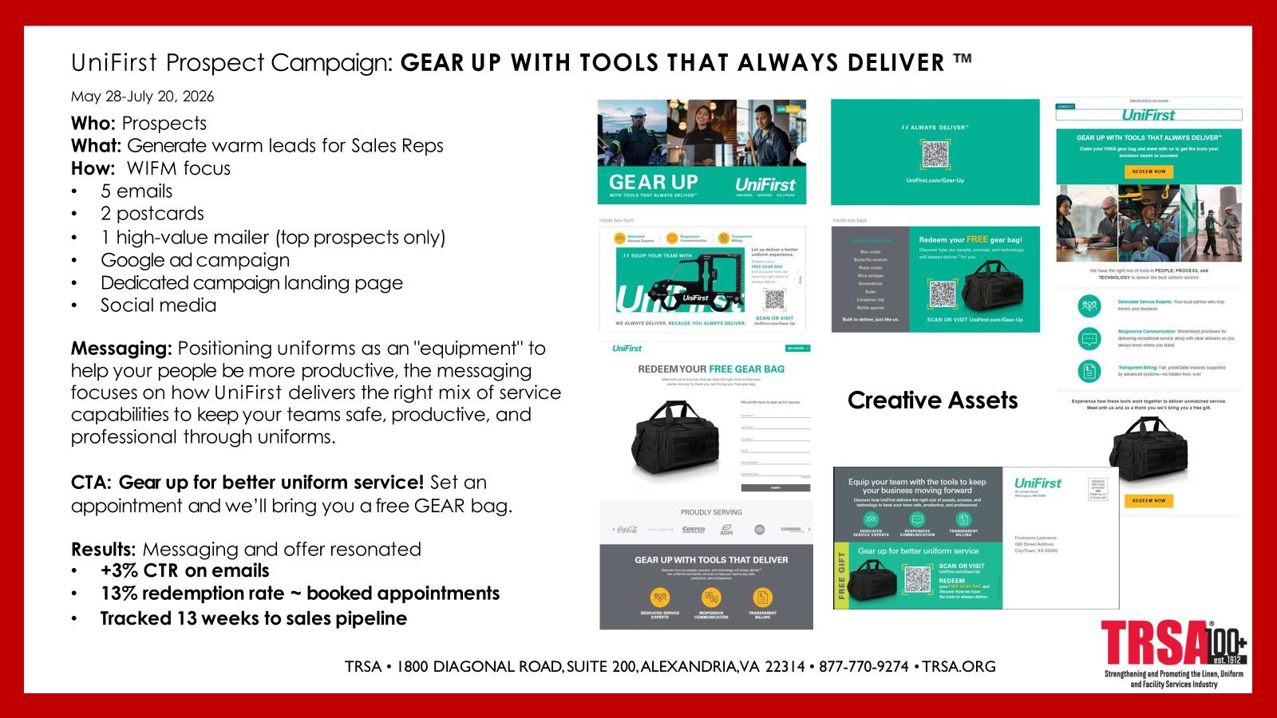

Slide 5

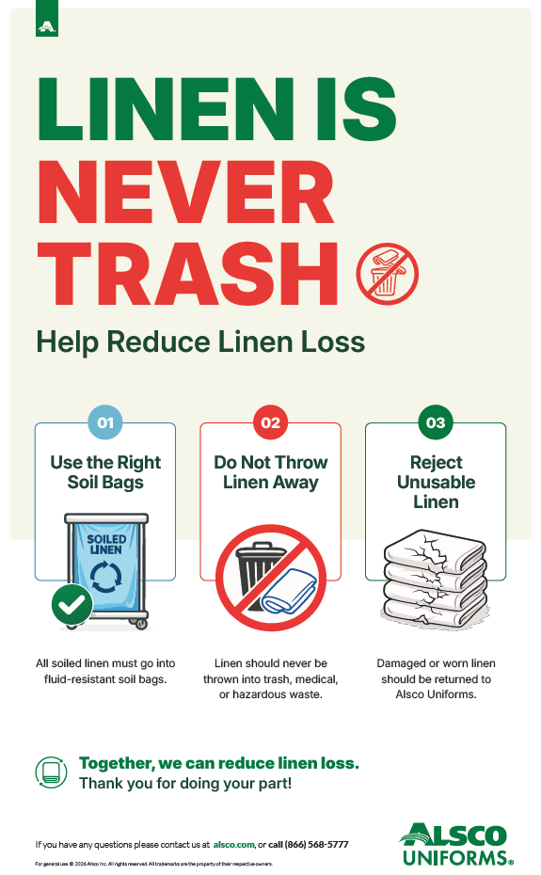

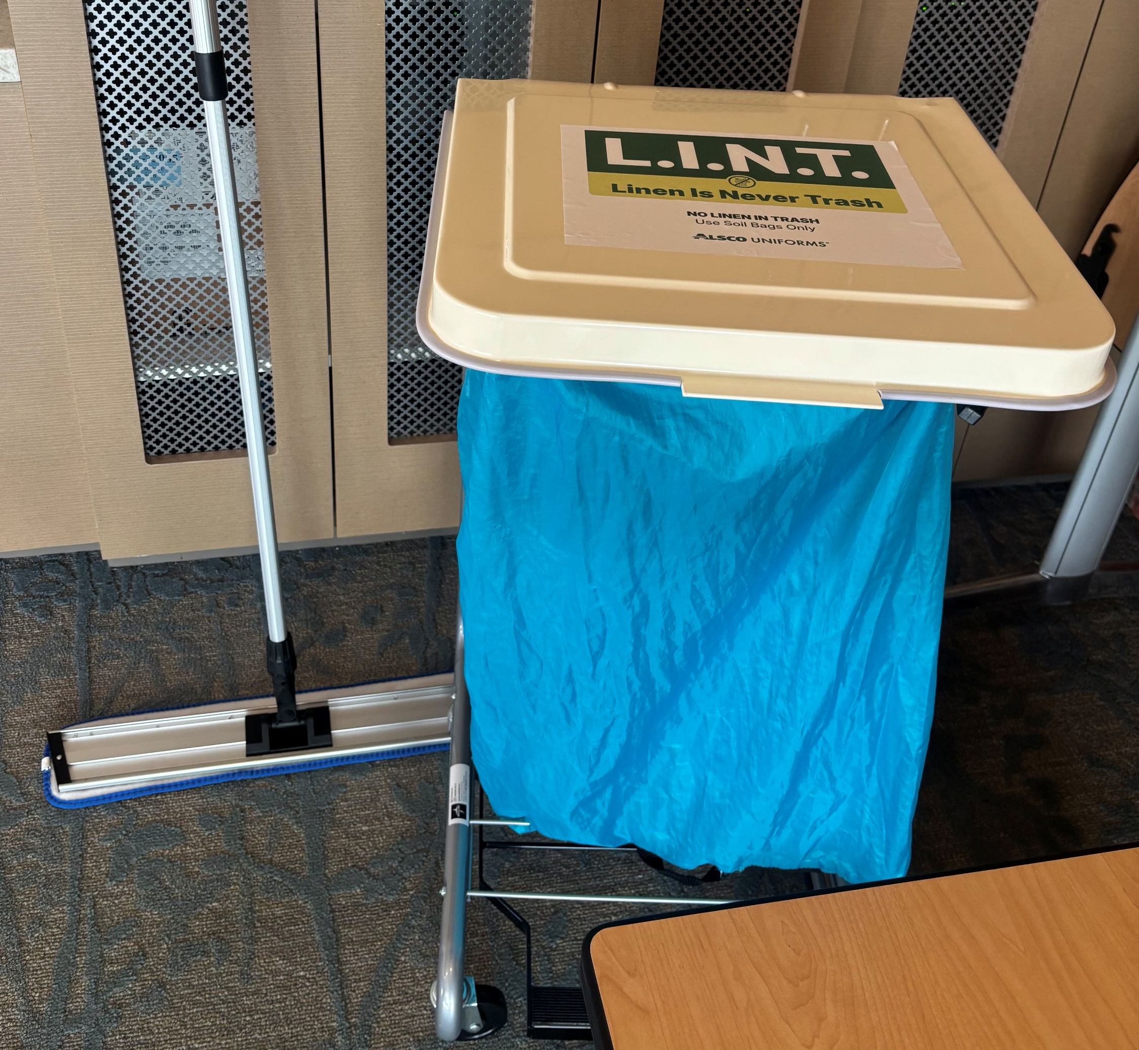
L.I.N.T. – Linen Is Never Trash
FLYER
POSTER
STICKER

Slide 6
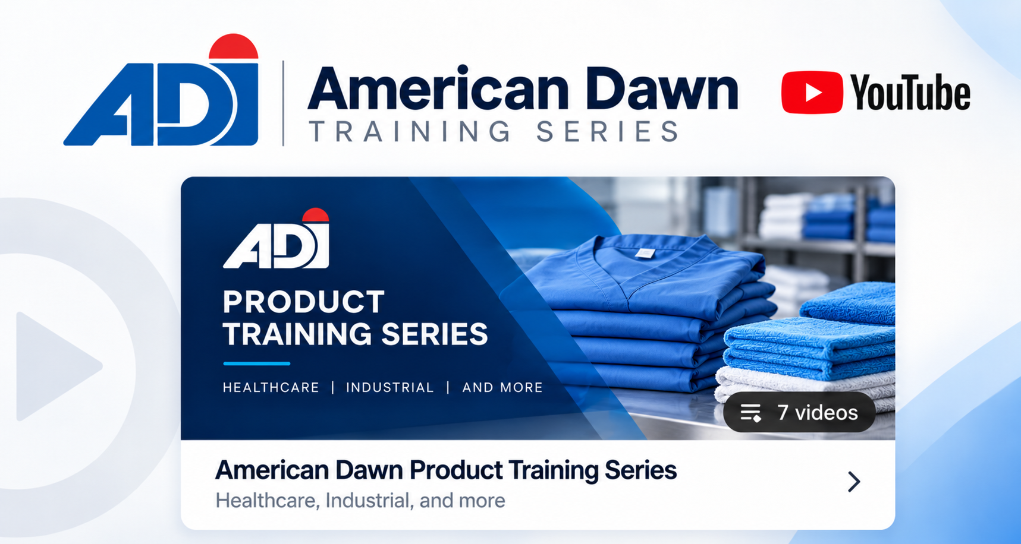
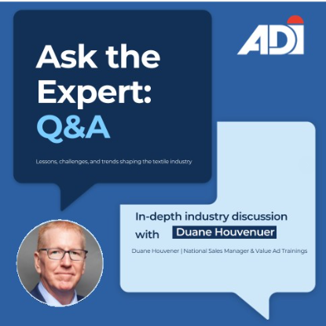
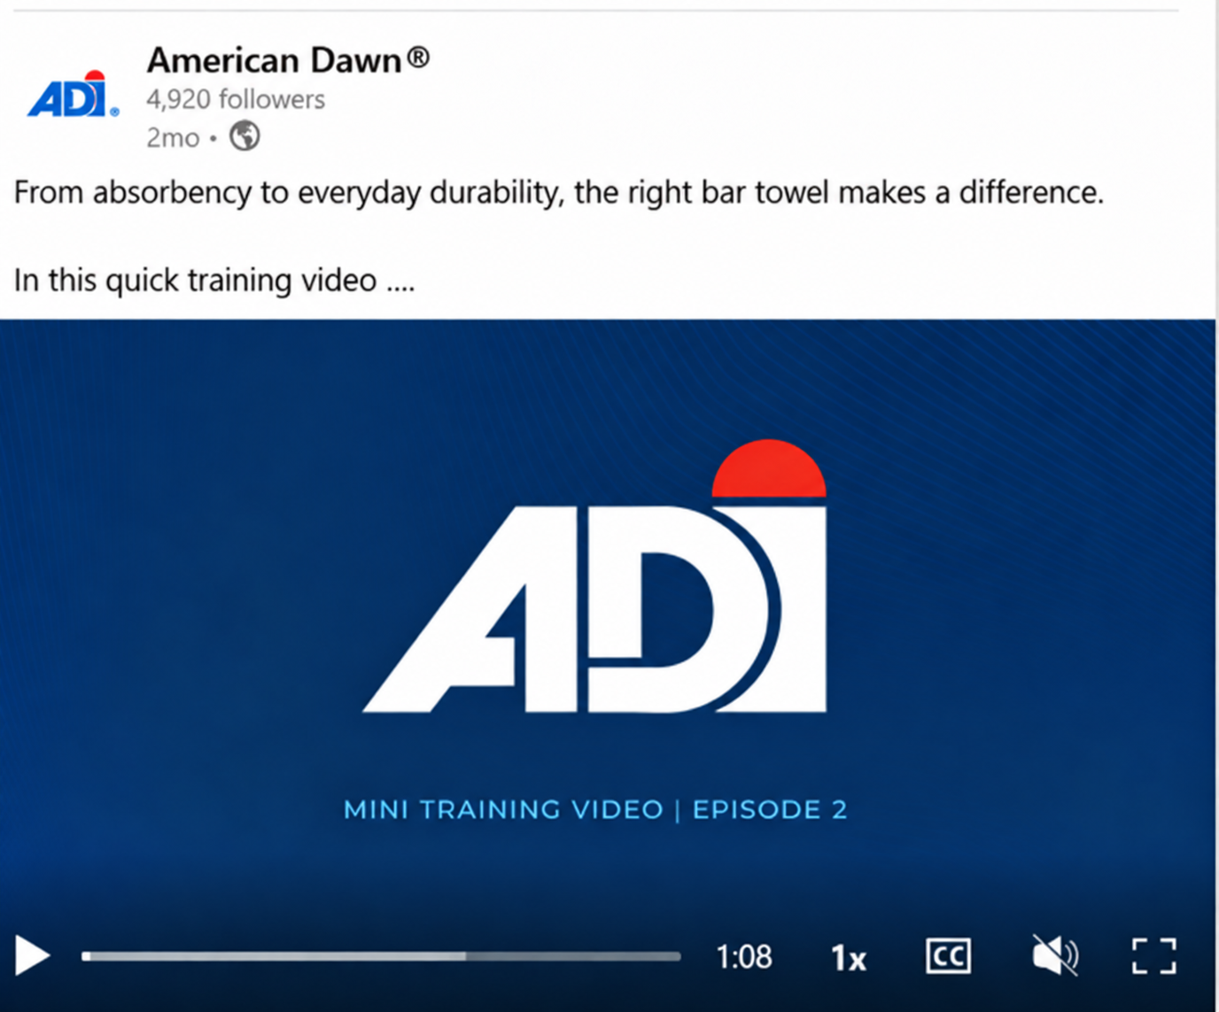
AMERICAN DAWN INC. (ADI)
ADI Product Training Series
A MULTI-STEP CAMPAIGN
1
Long-form YouTube training series
2
Short-form videos on LinkedIn
3
Digital training toolkits for customers
4
“Ask the Expert” series
Notes:
ONE-MINUTE TALK TRACK
At ADI, we believe the value of a product goes beyond the product itself. It's the expertise that comes with it.
So this year, our goal was to show customers that value by putting our team's knowledge to work for them.
We built a multi-step campaign. First, long-form product training videos on YouTube, led by our National Sales Manager, Duane Houvener. Second, we turned those into quick 60-second tips on LinkedIn. Third, we packaged the videos into digital training toolkits and sent them to our customers so they could train their own sales and service teams. And our Ask the Expert series sits down with our team to share what they know about where the industry is going.
When a laundry buys from ADI, they don't just get a great product. They get the training and expertise to sell it with confidence.
And we're just getting started. More videos are on the way. Thank you!

Slide 7

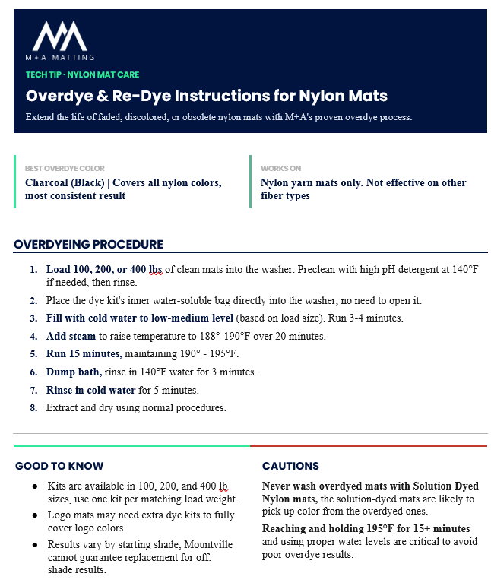




ASK MATTY
SALES & MARKETING INNOVATION
M+A Matting’s AI-Powered Sales & Service Assistant
Faster, accurate answers, no more “I’ll get back to you”
Recommendations matched to their facility and rental program
For the Customer
Instant access to specs, Tech Tips, and comparisons
Customer-ready decks, one-pagers, and quotes in minutes
For Our Sales Team
Faster onboarding with a training guide for new hires
Real-time answers replace back-office delays
For Customer Experience

